Slide 1
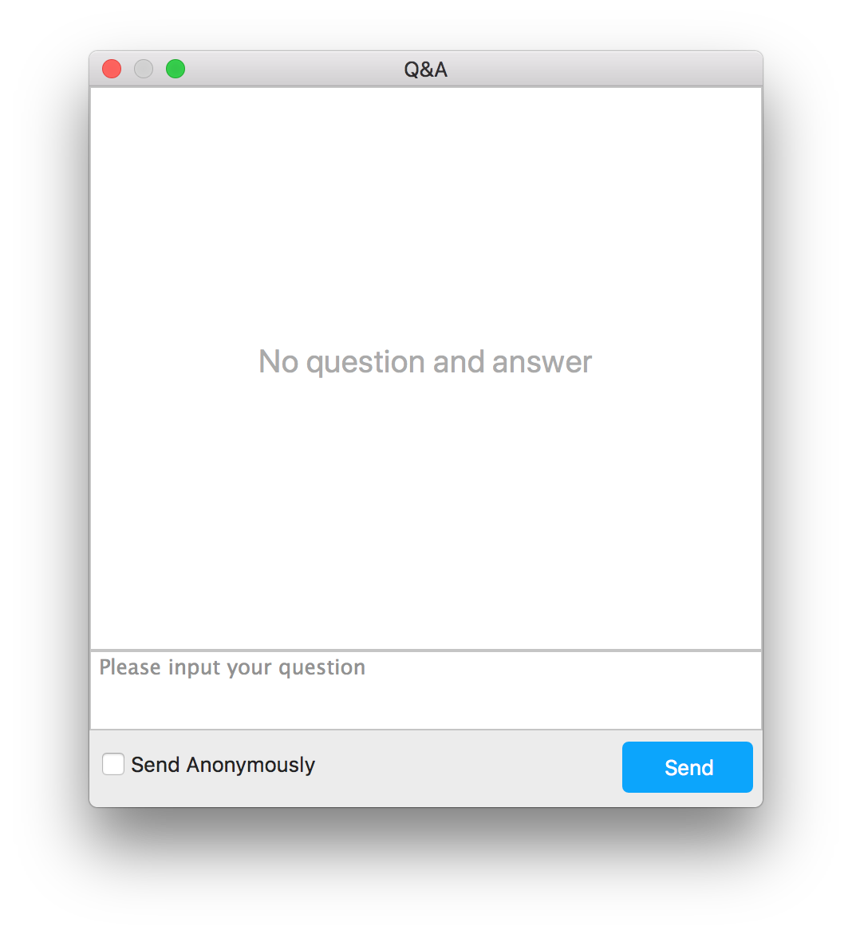
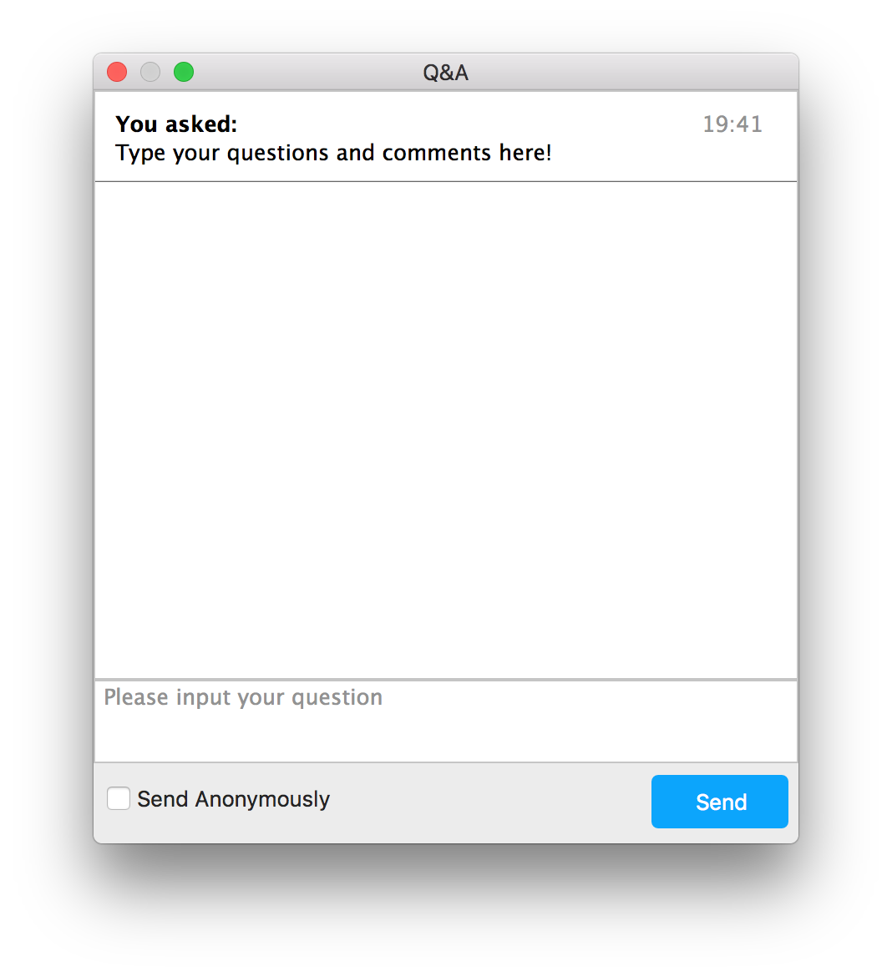
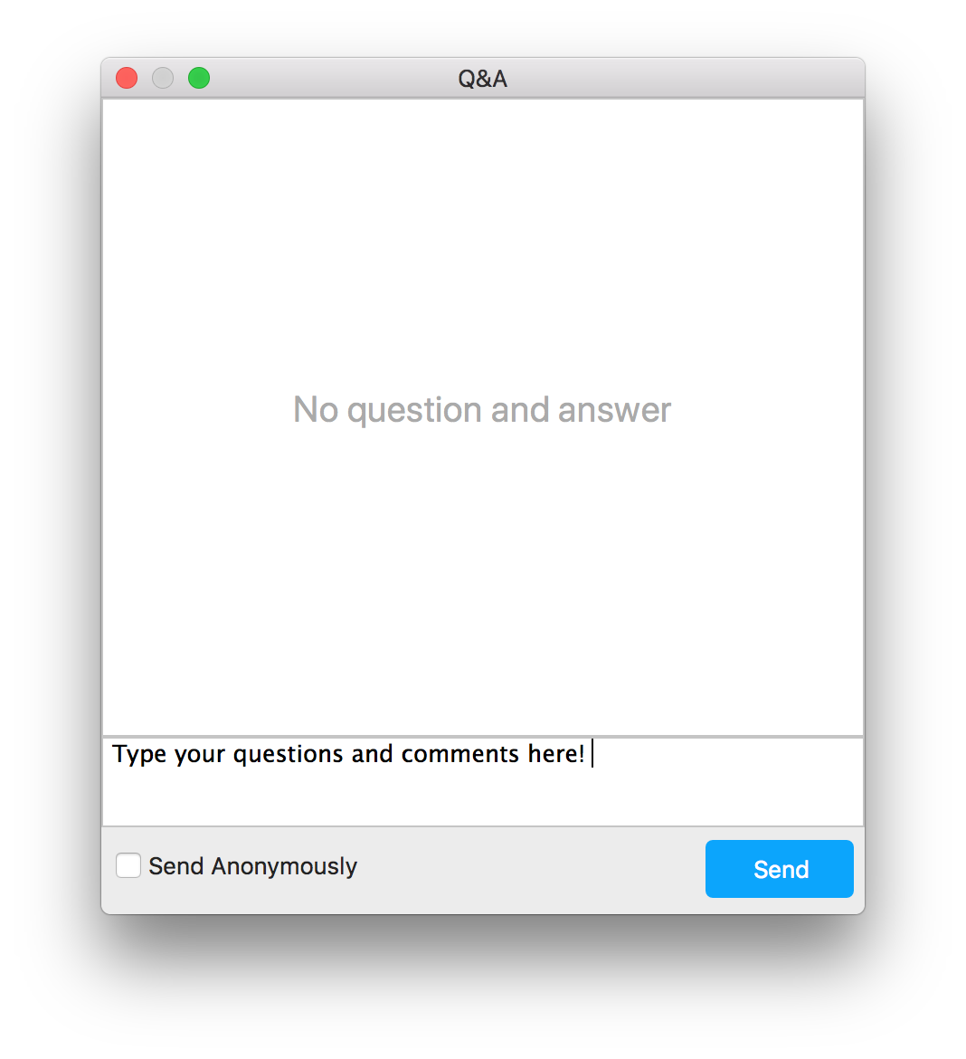
Upvoting
CV Webinar #2 –HOME Waivers under the CARES ACT
Notes:
Meeting v. Webinar Comparison
https://support.zoom.us/hc/en-us/articles/115005474943-Meeting-and-Webinar-Comparison

Slide 2
HOME Waivers for COVID-19 Response
NCDA Webinar
April 24, 2020

Slide 3
Panelists
Sheryl Kenny, Arlington, Texas
George Mensah, Miami, Florida
Galen Price, Waco, Texas

Slide 4
Topics
HUD’s HOME Waivers in April 10, 2020 Memos
Review General HOME Waivers
Review TBRA HOME Waivers
Eviction Moratorium Overview
City Responses to COVID-19 with HOME
How to access resources
Questions and Answers

Slide 5
HOME General Waiver Eligibility
Stafford Act Disaster Areas (waivers 1-4)
Applicable to areas with Presidential declaration of disaster for COVID-19. Includes all 50 states, but excludes American Samoa.
All Other Participating Jurisdictions (waivers 5-12)
Applicable to all PJs
Most waivers extend from April 10, 2020 to December 31, 2020.

Slide 6
HOME Waivers for PJs in Disaster Areas
Suspension of 10% cap on HOME Admin for FY19 and 20
Reduces CHDO set aside to “0” for FY17, 18, 19, 20 to free up HOME funds for TBRA or other COVID-19 response
May use up to 10% of FY19 and 20 HOME allocation for CHDO operating
Reduction of 100% of HOME match requirement for HOME expenses from Oct 1, 2019 to Sept. 30, 2021
Notes:
1. Allows up to 25% of HOME for increased cost of responding to COVID-19

Slide 7
HOME General Waivers for all PJs
Reduces public comment period from 30 days to 5 days for substantial amendments to Action Plan
Use of self-certification to determine HOME income eligibility
Extends timeframe for on-site inspections of HOME rental properties under affordability period
Extends deadline for TBRA annual inspections to 120 days after December 31, 2020.
Notes:
5. Applies to PJ plans to reprogram HOME for COVID-19 response

Slide 8
HOME General Waivers for all PJs
Extends HOME 4-year project completion deadline
Waives 9-month sale requirement for homebuyer units
Allows PJs to use HOME funds to assist troubled rental projects without HUD approval (within guidelines)
Extends timeframe for PJ corrective action of HUD HOME non-compliance issues

Slide 9
Waiver Quick Poll
Select answers to waiver questions
Let’s see how PJ’s are doing to access waiver flexibility

Slide 10
HOME TBRA Waivers
PJs may implement TBRA without market analysis in Con Plan and with 5 day comment for Action Plan funding
Waives requirement to update Con Plan with any new tenant selection criteria, but must document in files local criteria for assisting households with TBRA
Reduces public comment from 30 to 5 days for TBRA in Con Plan and Action Plan funding
Waives rent reasonableness for tenants with sudden loss of income, but requires rental assistance agreement.
Allows PJs to pay up to 100% of rent and utilities for eligible families

Slide 11
HOME TBRA Waivers
More flexible term of lease agreement start date
Flexible lease prohibitions, but must follow VAWA
Waives initial HQS inspections unless unit was built before 1978 (lead rules still apply)
Waives annual HQS inspections until after Dec 31, 2020
May use self-certification for income determinations

Slide 12
TBRA Waiver Quick Poll
Do you plan to take advantage of the TBRA waivers to address COVID-19 in your community?

Slide 13
Eviction Moratorium
Sec. 4024(b) of the CARES Act prohibited covered properties from filing new eviction actions for non-payment of rent, and also prohibits “charging fees, penalties, or other charges to the tenant related to such nonpayment of rent.”
Sec. 4024(c) provides that a lessor (of a covered property) may not evict a tenant after the moratorium expires except on 30 days’ notice—which may not be given until after the moratorium period.
Up to 120 days from the date of the act (March 27, 2020)

Slide 14
Eviction Moratorium 2
What properties are Covered?
Violence Against Women Act (VAWA) Covered Properties
HOME program
HOPWA program
McKinney-Vento Act homelessness programs
And other programs
Low Income Housing Tax Credit Properties (LIHTC)
Properties with Federally Backed Mortgage Loans (1-4units) and (5+ units)

Slide 15
Eviction Moratorium 3
What should we do?
Notify all projects covered by this eviction moratorium about their obligations under the CARES Act.
HUD will be providing an FAQ to further provide PJs with their responsibilities under the Act.

Slide 16
Large City Response – Miami, FL
Asked for all waivers- Gives you flexibility in case you must design a new program
Using the 25% admin funds flexibility for 2019 and 2020 to ensure that no general funds are used for administration of the HOME program
Designing a TBRA program to provide rental assistance under previously executed leases.
We are in the process of discussing with our CHDOs to see if any of them need funds that will require using the CHDO operational expense waiver

Slide 17
Small City Response – Waco, TX
Reallocation of unused CHDO Set-Aside funds to TBRA
- $102,500
Plan to increase TBRA allocation in FY20 Action Plan using reallocated CHDO Set-Aside funds
$107,350
Waivers to be used in support of TBRA
Payments up to 100% of the cost of rent, deposits, and utilities
Will assist tenants under previously executed leases

Slide 18
Medium City Response – Arlington, TX
Submitted to HUD a request for all waivers, in case they are needed during the waiver period
Currently administers TBRA and will expand that program and use flexibility of waivers
Will offer a variety of rental assistance programs, including CDBG, ESG, and HOME (Arlington does not receive HOPWA)

Slide 19
Resources + Q & A
HUD General HOME COVID-19 Waivers
https://files.hudexchange.info/resources/documents/Availability-of-Waivers-and-Suspensions-of-the-HOME-Program-Requirements-COVID-19.pdf
HUD TBRA HOME COVID-19 Waivers
https://files.hudexchange.info/resources/documents/Suspensions-and-Waivers-to-Facilitate-Use-of-HOME-Assisted-TBRA-COVID-19.pdf
HUD HOME COVID-19 Resource Page
https://www.hudexchange.info/resource/6017/cpd-memo-suspensions-waivers-home-tbra-covid-19/
NCDA COVID-19 Program Documents
https://ncdaonline.org/covid-19-documents/

