Slide 1
Planning for National Community Development Week
National Community Development week: Kettering Style
Angela Rahman, Community Development Manager,
City of Kettering, Ohio
March 31, 2025

Slide 2
Why We Bother Celebrating This Every Year
Because CDBG is amazing and no one knows what it is
A chance to show off our impact and humblebrag just a little
We rally our electeds, staff and regional partners – sometimes with snacks* (donated, of course)
Also: It’s the one week a year we are allowed to be extra at work!

Slide 3
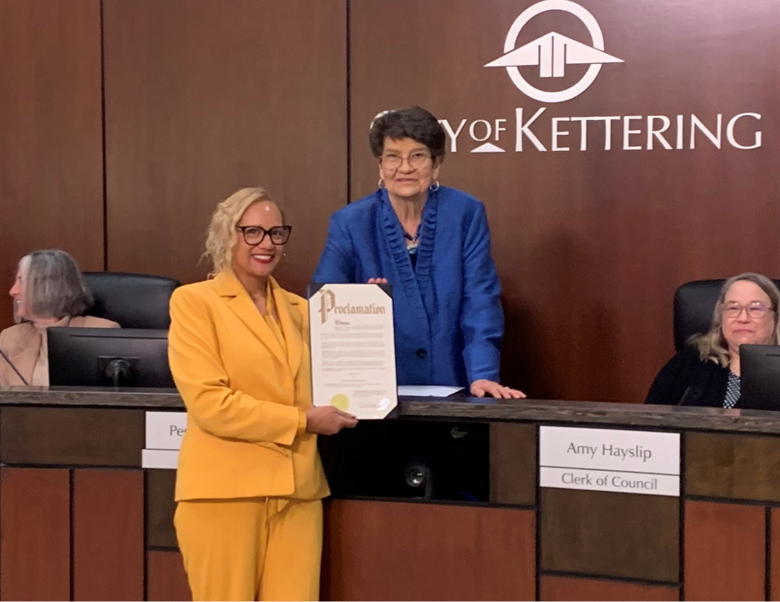
Low hanging fruit: The All-Important Proclamation
What’s a celebration without a City Council proclamation?
Elevates visibility and demonstrates elected officials’ support
Publicly read at a Council meeting and posted on city channels

Slide 4
The Videos – aka Oscar Season for Community Development Staff!
We don’t do boring. We do costumes. We do characters. We do… Star Trek… and disco!
Its fun, its informative and it gets way more views than a memo!
Staff involvement + Community voices = Engaging and sharable content

Slide 5
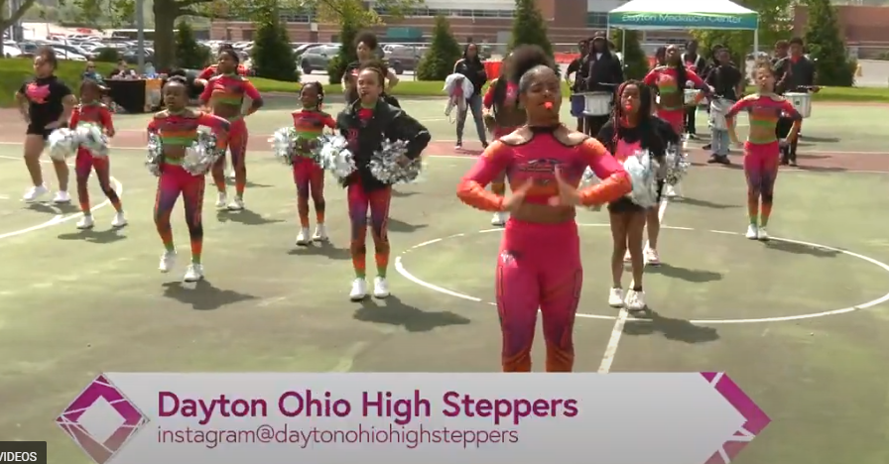
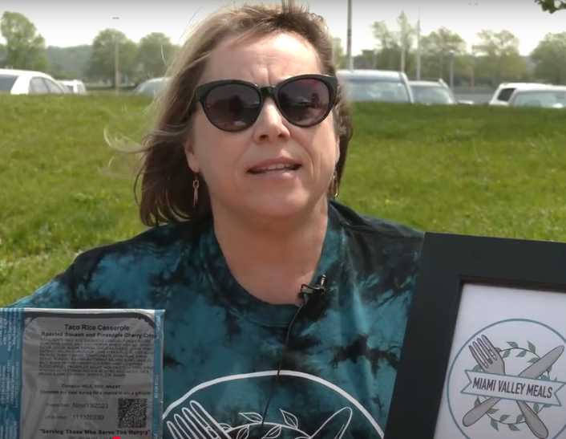
Collaboration Station
Partnerships
Partnered with Dayton and Montgomery County
Joint Video
Subrecipients, Food Trucks, Entertainment!
Resource Fair

Slide 6
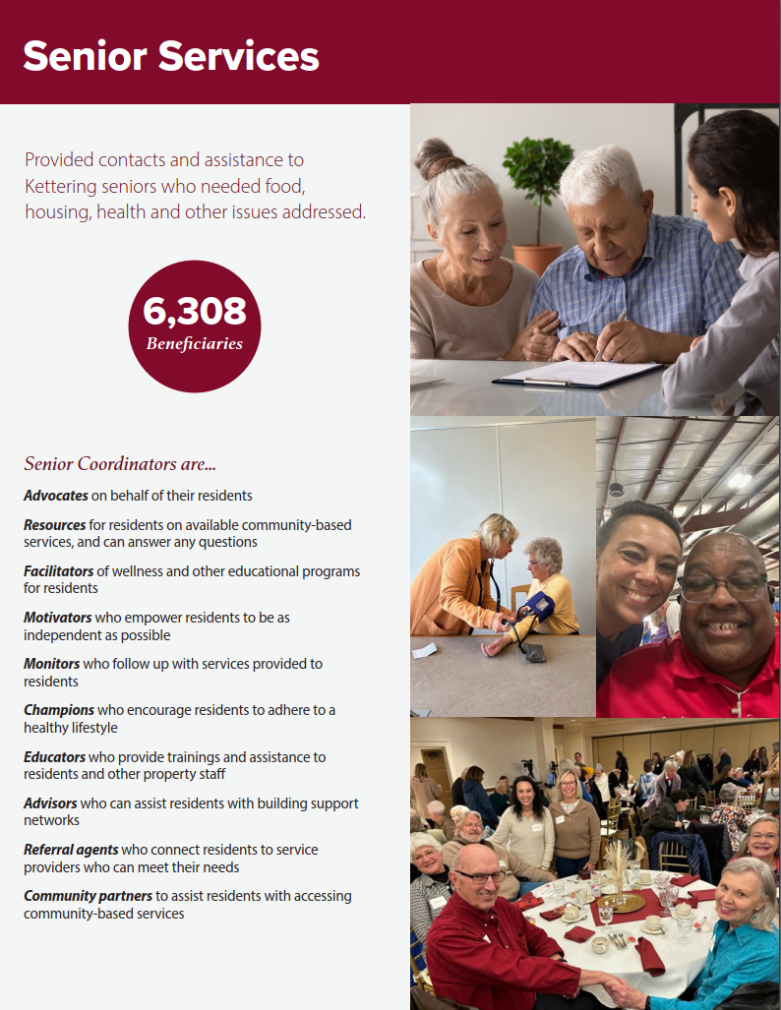
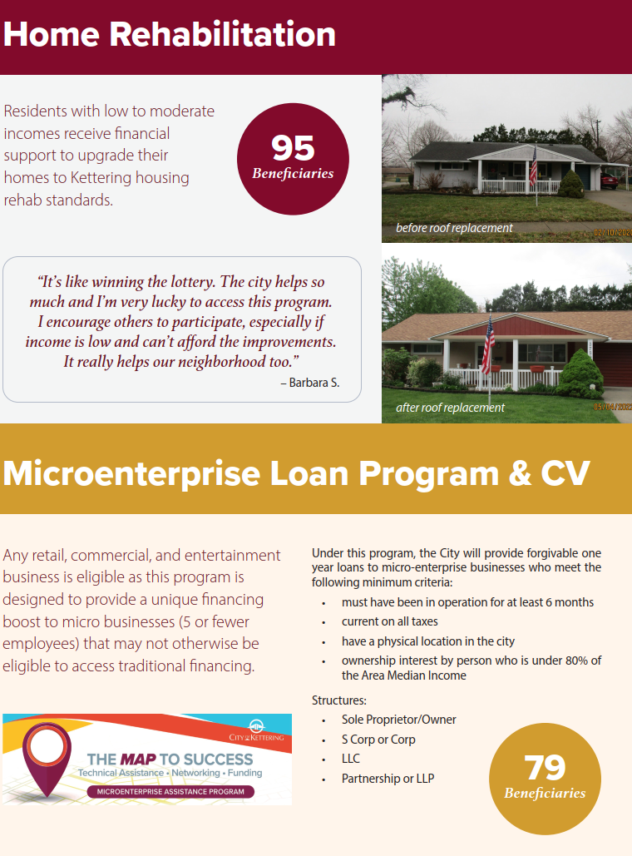
Our Glorious Brochure Tells our CDBG story with heart, data and decent typography….

Slide 7
The Wrap Up: What Works and Why
Storytelling matters!
Nobody’s inspired by line items and legalese
Regional teamwork makes the dream work
Leverage local government support (proclamations, events)
Celebrate wins big and small- your community deserves it!
How to contact us:
Community Development
3600 Shroyer Rd
Kettering, OH 45044
Angela.Rahman@ketteringoh.org
937-296-2441

