Slide 1
Pasco County, Fl
Celebrating CD Week

Slide 2
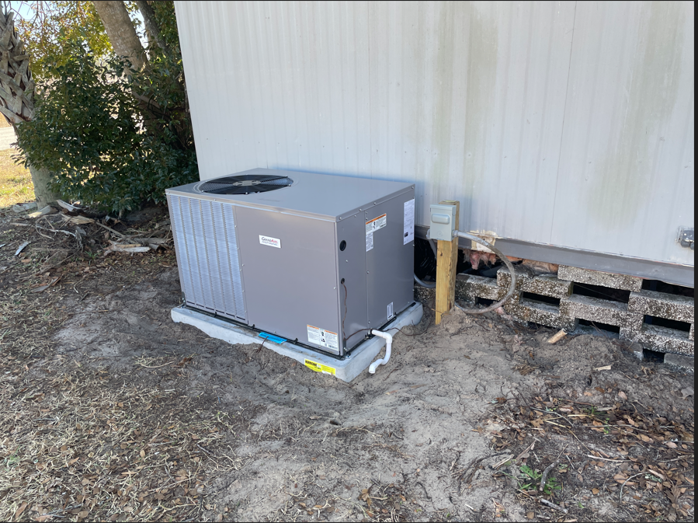
Why?
Increase awareness of the need and impact for CDBG and HOME funding
How are your program funds invested in the community to meet critical needs?
Who is benefiting from program funds?
Highlight examples
CAPER
Notes:
Be prepared.
The purpose of CD Week is to show the need and impact for funding
A pat on the back also
Information can be taken from the CAPER and Action Plans
Be ready to highlight examples
Pasco County has highlighted Audrey Nelson award winning projects during CD Week to add to the impact

Slide 3
Build on YOUR Strengths/Use What You Have
Press Release
Social Media
CD Week Tool Kit
Build off of prior year activities
Highlight activities
Notes:
Pasco County has a department that assists with the Press Release
We work with media specialists for all social media posts
What worked last year? What did not work?
We are fortunate to have a media specialist able to secure interviews for a local morning show and are able to highlight CDBG activities and CD week
Last year we heard our Congressman would be in the area and we were able to arrange a meet and greet for him at a local business that had been assisted with ED. We had won the Audrey Nelson for Amskills and we used CD week to highlight ED activities
SWAG – who doesn’t like SWAG?

Slide 4
Tips and Tricks
Start early
Build off of last year
This is not a competition
Budgets
Staffing
Activities do not have to occur every day
Use the CD Week Tool Kit – there are examples and samples for everything
Notes:
What was successful last year? What do you wish you could redo?
Start early because somethings have a process – such as having a commissioner sponsor the resolution
Can have all social media posts ready to go and relax
Different communities have different capacities.
$3,099,096 CDBG
$1,167,197 HOME
2.5 grant manager
You aren’t competing with a larger entitlement. Do the best you can
Do SOMETHING

Slide 5
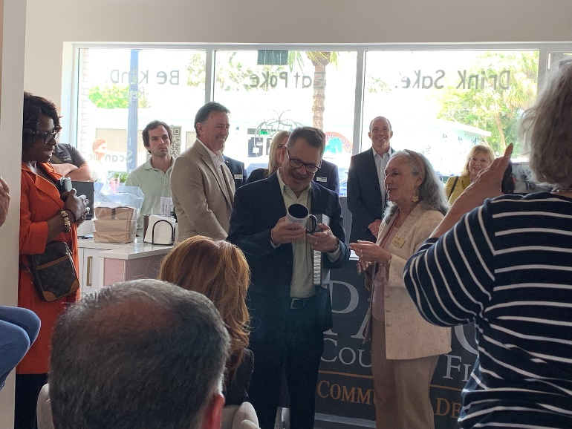
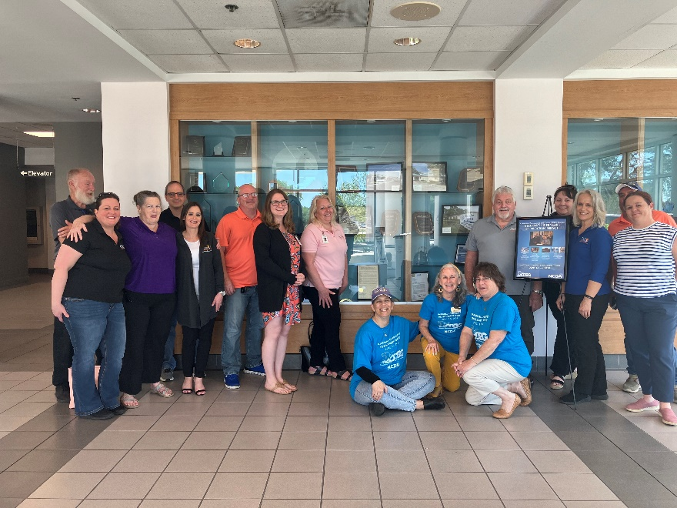
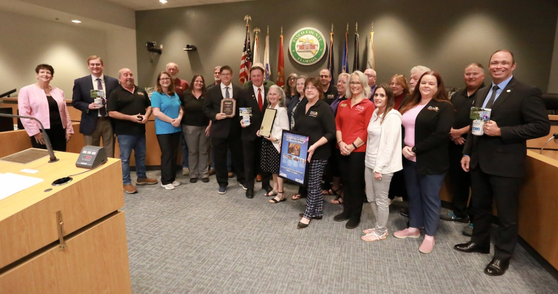
It Doesn’t Have to be Expensive to be Effective
Notes:
Pictures of Swag with pictures – what you don’t see are the bullet point facts on the back
Giving Congressman Bilirakis a CDBG Mug
2024 Resolution
Posing in front of awards in the government center

Slide 6
Pasco County Planned Activities for CD Week 2025
Monday April 21, 2025 – PCCD Director to appear on Morning Blend with PRNR Director to discuss how CDBG funds made Lake Lisa a reality
Tuesday April 22, 2025 – PCCD will receive a resolution in honor of CD Week. PCCD will gift County Commissioners with a Lego set because “CDBG are the building blocks of our Community”
Wednesday April 23, 2025 – PCCD open house, meet our new director.
Daily Social Media Posts
Provide agencies with postcards and stamps for beneficiaries to mail to elected officials
Notes:
Social Media posts will be done in advance
We provide stamps and addresses of elected officials to make it easier for beneficiaries to write to their elected officials; we also provide a blurb of what someone might say if they don’t have any other ideas.

Slide 7
2024 CD Week Kick Off with Congressman Bilirakis
Notes:
We made this awesome graphic from pictures of Congressman Bilirakis’s visit and the logo from the CD
He visited the week before and we took the opportunity to tie his visit to CD Week

Slide 8
Lighthouse for the Blind
Notes:
Easter Egg hunt for blind children

Slide 9
Metropolitan Ministries
Notes:
Touring Metropolitan Ministries

