Slide 1


Office of Davis-Bacon and Labor Standards
National Community Development Association
Council of State Community Development Agencies
November 14, 2022
Presented by: Jennifer Dupont
Jennifer.A.Dupont@HUD.gov

Slide 2
GOALS and AGENDA
Brief overview of DBLS
DBLS Administration
  Applicability
  Contracts
  Wage Decisions
DBLS Enforcement
  Certified weekly payrolls
Reporting
Monitoring

Slide 3
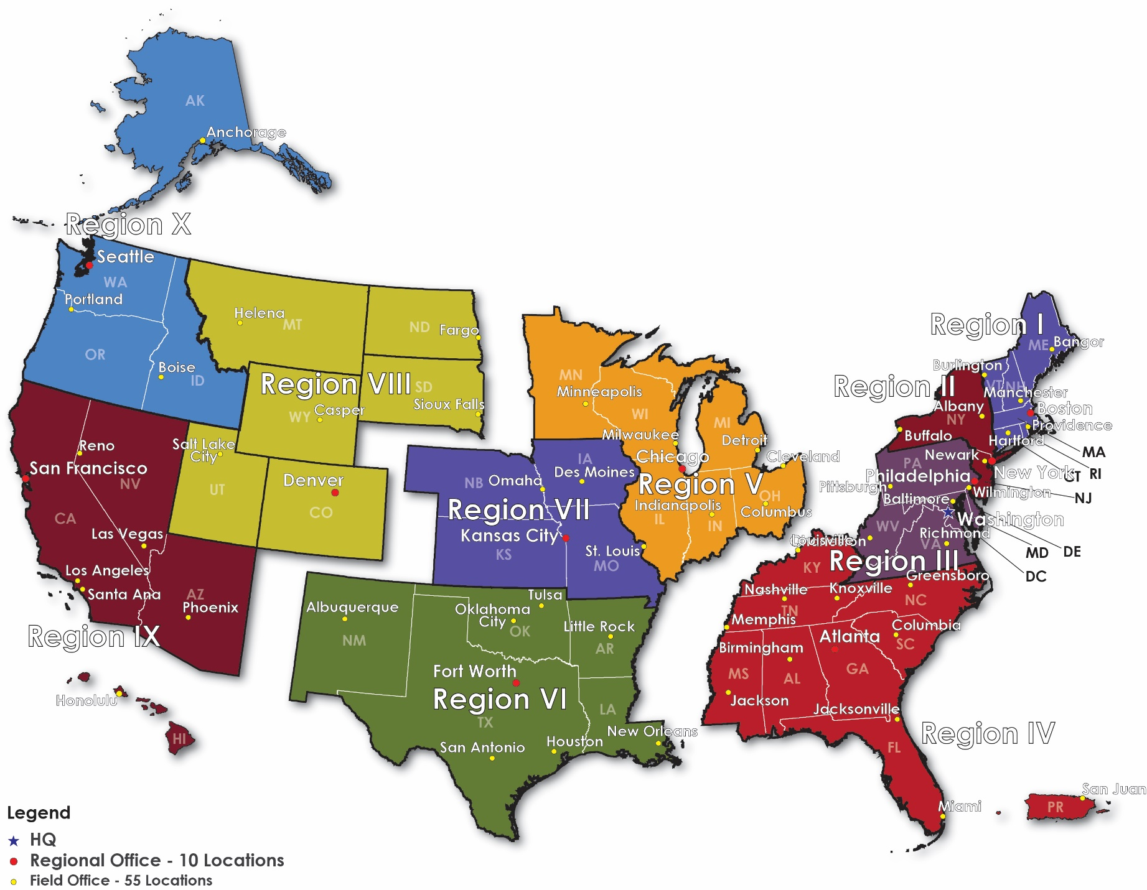
DBLS Organization & Staffing
DBLS Headquarters
Amanda Herrmann Vasquez
National Director
Jennifer Dupont
Program Analyst
Patricia Wright
Senior Management Analyst
DBLS Hub Directors
Eastern Hub: Debra Bensala
Central Hub: Jerlinda “Linda” Banks
Western Hub: Matthew DuFresne
https://www.hud.gov/program_offices/davis_bacon_and_labor_standards/laborrelstf

Slide 4
DBLS Statutory Responsibilities
  Oversight to over 4K agencies across the country receiving over $11B in direct HUD funding (entitlement funds through PIH, CDBG, HOME, etc.)
  DBLS provides direct contract administration to 542 projects receiving over $13B in HUD grants, and mortgage insurance.

Slide 5
What we do…
Training 20% - Training of contractors on projects we have direct oversight. Training of LCAs.
Technical Assistance 5% –Staff also provided TA to LCAs, contractors in complying with regulatory and policy requirements.
Monitoring 25%- Staff perform annual risk assessments to determine which agencies pose a higher risk to HUD for non-compliance. From these assessments, staff develop annual monitoring and training plans for the upcoming fiscal year.
Maintenance Wage Decisions (MWD) 20% – Staff establish wages for maintenance staff working in public and Indian housing authorities.
FHA Project Administration 25% – Staff provide direct contract administration and enforcement to multifamily and health programs where Davis-Bacon requirements are mandated.
Special Projects 5% - Several projects are ongoing to improve and streamline DBLS work. These include the Handbook rewrite and associated materials, updating DBLS directives, Worker Pocket Guide, Translation of our documents into different languages.

Slide 6

Office of Davis-Bacon and
Labor Standards
For projects funded or assisted by HUD Programs,
we ensure that construction and maintenance workers are paid properly.
Administrative and Enforcement Responsibilities
Oversight Responsibilities

Slide 7
KEY Davis-Bacon & Related Statues
Davis-Bacon Act (DBA)
Copeland Act
Requires all laborers and mechanics be paid a prevailing wage.
Contracts over $2K
Site-based
Requires weekly payment of wages
Anti-Kickback Act
Regulates deductions
Requires payrolls be certified
OT Provision automatically applied to prime contracts >$100K
Liquidated damages $29 per day/per violation
U.S. Housing Act of 1937, Section 12(a)
HCDA of 1974 (CDBG), NAHA of 1990 (HOME)
Etc.
CWHSSA
Related Acts

Slide 8
Related Acts
The WHY

Slide 9
HUD Related Acts
Public Housing
  U.S. Housing Act of 1937, Section 12(a)
  RAD
CDBG
  Housing and Community Development Act of 1974, Sec. 110(a)
    CDBG-DR; NSP; CARES
HOME
  National Affordable Housing Act of 1990, Sec. 286(a)
    ARP
  Multifamily Programs
    221(d)(3) & (4)

Slide 10
FACTORS of
APPLICABILITY

Slide 11
CDBG APPLICABILITY
“All laborers and mechanics employed…on construction work financed in whole or in part…shall be paid [prevailing wage rates].” Section 110(a) of the HCDA of 1974
  Primary construction contract is $2,000 >
  Unit thresholds may apply (8+ units)
  Soft cost generally do not trigger DB
  Force account worker is exempt (except for PHA staff)
  Volunteers are exempt

Slide 12
HOME APPLICABILITY
Sec. 286 of the HOME Investment Partnerships Act (Title II
of the Cranston-Gonzalez National Affordable Housing Act).
  DB is applicable to contracts for the construction of affordable housing with 12 or more HOME-assisted units. Applicability depends on how many HOME-assisted units are under the contract; not how many units are in the HOME project.
    Soft costs will trigger DB
    Once triggered, DB applies to entire project
    Sweat equity is exempt

Slide 13
HOME ARP
The Ask
  Submit Plan
  Deadline is March 31, 2023
WEBINAR November 15th 2:00pm – 3:15pm
Understanding the HOME-ARP Allocation Plan Submission Deadline and Fund Reallocations
https://www.hudexchange.info/trainings/courses/office-hours-understanding-the-home-arp-allocation-plan-submission-deadline-and-fund-reallocations

Slide 14
HOME ARP
Notice: CPD-21-10
  Requirements for the Use of Funds in the HOME ARP Program
  https://www.hud.gov/sites/dfiles/OCHCO/documents/2021-10cpdn.pdf
Notice: CPD-22-13
  Submission of Plan and Reallocation of Funds
  https://www.hud.gov/sites/dfiles/OCHCO/documents/2022-13cpdn.pdf

Slide 15
Davis-Bacon Wage Decisions
Building
Residential
Apartment buildings greater than 4 stories, Sheltered enclosures for the purpose of housing persons, machinery, or equipment, Commercial Buildings
Single family houses, townhouses, Apartment buildings 4 stories or less
The Department of Labor defines the type of work that is called for in the contract for construction the Character of Construction. They define four primary categories: Residential, Building, Heavy and Highway.
Heavy
Projects which don’t fall into any other category, Dredging, Water & Sewer Lines, Parks and Playgrounds, Flood Control
Highway
Roads, Highways, Sidewalks, Parking areas, Other paving work not incidental to other construction

Slide 16
Davis-Bacon Wage Decisions
Obtain Wage Decision
www.sam.gov
AAM 130 & 131
https://www.dol.gov/sites/dolgov/files/WHD/legacy/files/memo-131.pdf
AAM 236
https://www.dol.gov/sites/dolgov/files/WHD/AAM/AAM236.pdf

Slide 17
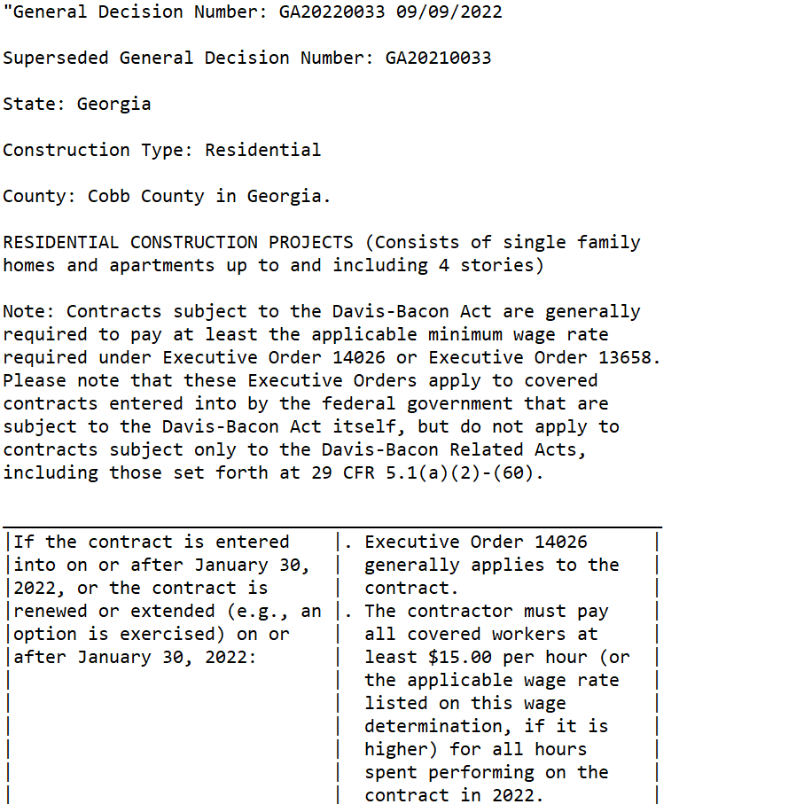






Slide 18
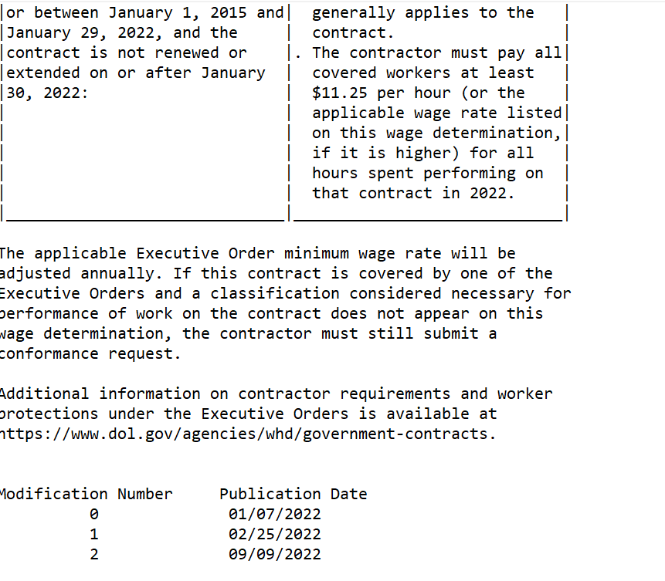







Slide 19
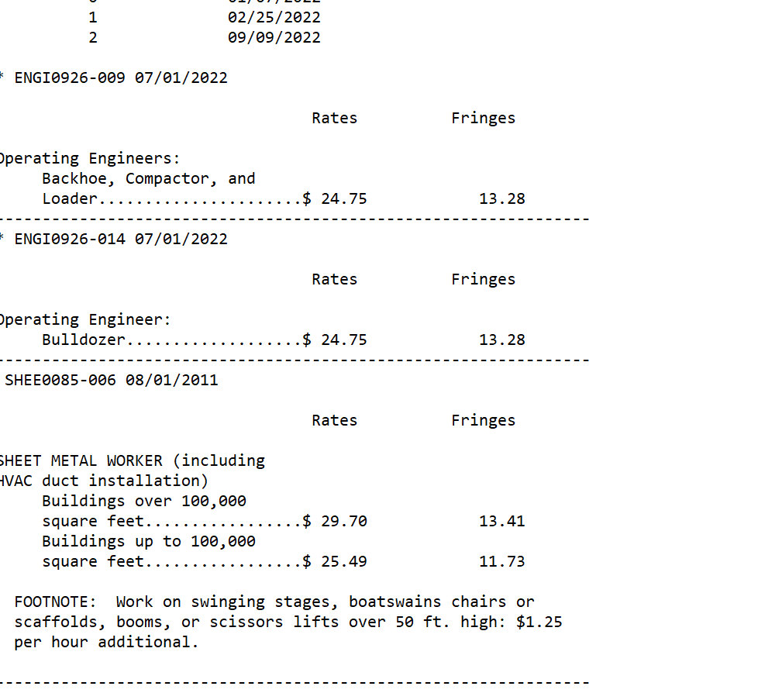



Slide 20
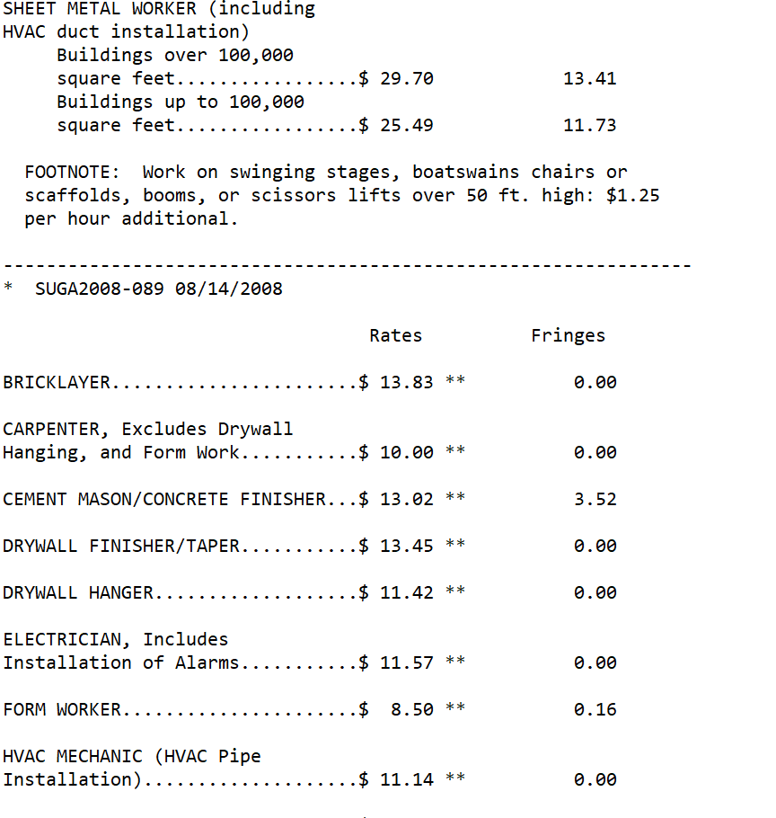


Slide 21
Davis-Bacon Wage Decisions
Posting and Lock-In Dates
Post in an area accessible to all workers
DOL Poster
English: https://www.dol.gov/agencies/whd/posters/dbra
Spanish:
https://www.hudexchange.info/resource/2662/wh-1321-davis-bacon-poster-en-espanol/
Wage Decision Lock-In Dates
Competitive Bids - Bid opening provided the contract is awarded within 90 days.
Negotiated Contracts – Contract award or construction start, whichever occurs first
RAD – Sign HAP agreement (final closing), or construction start, whichever occurs first

Slide 22

Contract for Construction Documents
Ensure incorporation into contract document
1. Current appropriate wage decision applicable to the work being done.
2. Applicable Federal Labor Standards Provisions
CDBG/CDBG-DR/HOME/NSP, TCAP
HUD-4010
https://www.hud.gov/program_offices/davis_bacon_and_labor_standards/olrform
3. Verify prime contractor eligibility – print results/document file
www.sam.gov

Slide 23
Davis-Bacon
Additional Classifications

Slide 24



Additional Classification Process
Review decision for missing classifications
Discuss with contractors
Submit SF-1444 AFTER contract award
1
Work not represented on the wage decision
Area practice
Reasonable Relationship Standard
Consent of all parties
Employers rights
2
Post new classification and rate
Applicable for this project only
Restitution payment if necessary
Obtain documentation
3
2

Slide 25
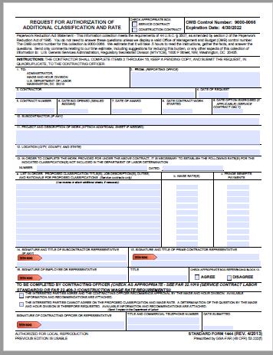
SF-1444
Submit completed form, along with Applicable Wage decision to
WHD-CBACONFORMANCE_INCOMING@dol.gov

Slide 26
Certified Weekly Payroll Reports
&
Employee Interviews

Slide 27
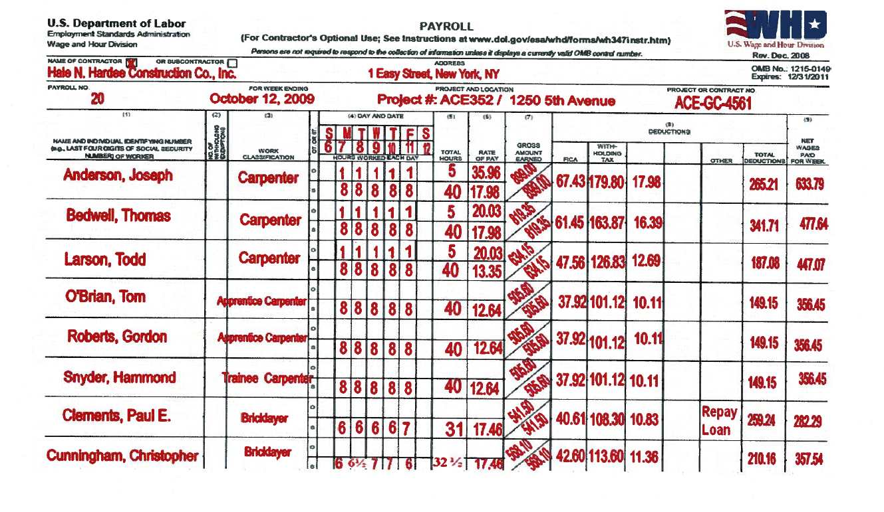
Certified Weekly Payroll

Slide 28
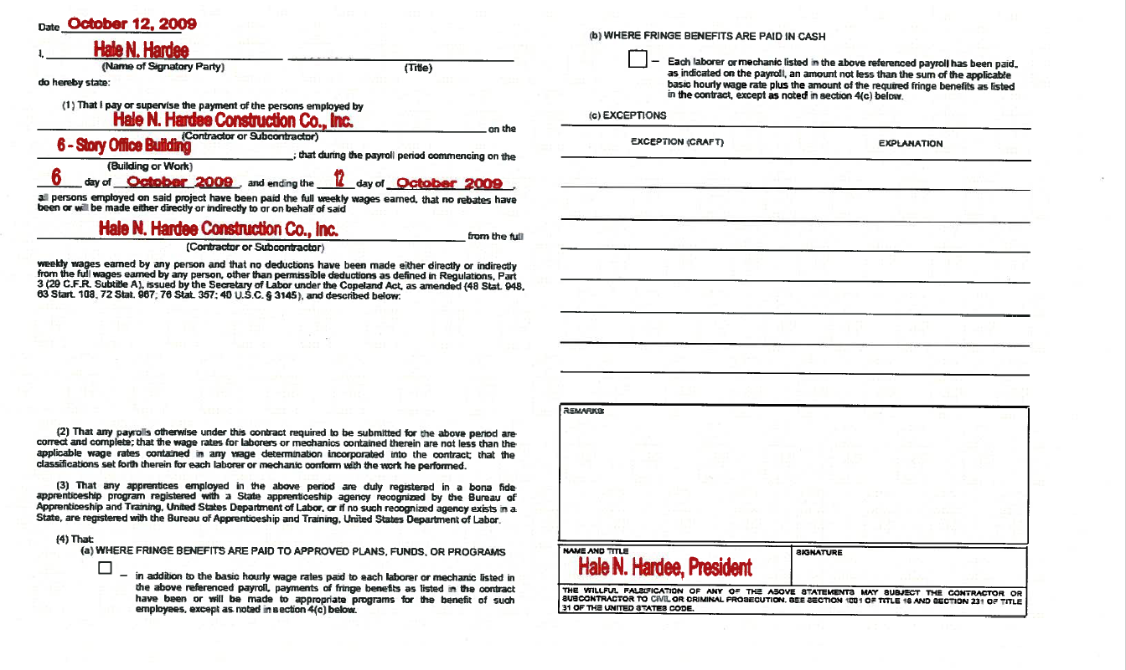
Certified Weekly Payroll

Slide 29
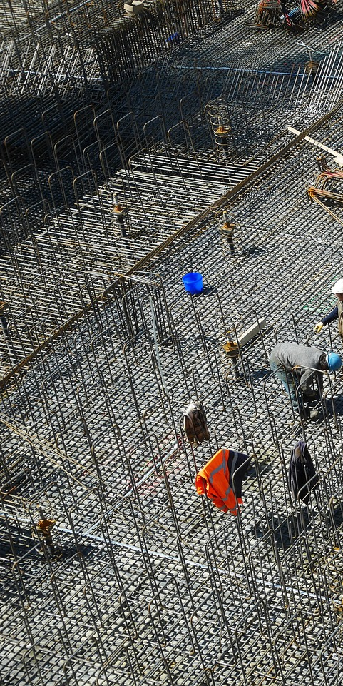
CONSTRUCTION SITE
Agency Basics
Ensure Submission
Conduct on-site interviews (HUD-11)
Check payrolls/related records
Ensure correction of underpayments
Prepare and submit required reports, if necessary
Maintain records for 3 years

Slide 30
CONSTRUCTION SITE
Agency Basics
Spot Check Payrolls
Review for major trades
Detect patterns
Compare on-site interviews
Focus on falsification
Ensure corrections, as needed

Slide 31
CONSTRUCTION SITE
Agency Basics
Falsification Indicators
Ratio of laborers to mechanics >1:1
Too few or irregular hours
Discrepancies in wage computations
Extraordinary deductions
Worker complaint

Slide 32
CONSTRUCTION SITE
Agency Basics
Follow-up
Communicate routine review results by phone – document with memo to file
Take corrective action promptly
Notify contractor in writing of violations if not corrected promptly after informal request
Always send written notification of serious violations of when sanctions/withholding are probable
Provide appeal rights to employer

Slide 33
CONSTRUCTION SITE
Agency Basics
Correcting Violations
Require appropriate documentation – require certified correction payroll report
Obtain written assurance of future compliance for substantial violations
Submit report to HUD DBLS restitution >$1,000 per employer
Track all restitution for Semi-Annual Report

Slide 34
Reporting

Slide 35
Labor Standards
Enforcement Reports
(HUD-4710)
1
5.7(a) Reports
Case by Case
Employer underpays by >$1,000
Violations appear aggravated or willful
Recommendations on debarment; CWHSSA liquidated damages
2
5.7(b) Semi-Annual
October 1 – March 31and
April 1 – September 30
Report DB covered contracts for construction awarded within reporting period
Report enforcement activity – regardless of award

Slide 36
HUD Monitoring

Slide 37
HUD Monitoring
Specialist conducts annual risk analysis (RA)
  Last date monitored
  Funding
  Activity
  Experienced staff
  Submit reports timely and correctly
Develop monitoring & training plan based on results of RA
Notify agency as least 30 days before on-site review.
Allow agency at least 30 days to complete remote monitoring review (desk review)
Finding vs Concern

Slide 38
References
HUD DBLS
https://www.hud.gov/program_offices/davis_bacon_and_labor_standards
DOL WHD DBRA
https://www.dol.gov/agencies/whd/government-contracts/construction
DOL Prevailing Wage Resource Book
https://www.dol.gov/agencies/whd/government-contracts/prevailing-wage-resource-book
DOL Field Operations Handbook, Chapter 15
https://www.dol.gov/agencies/whd/field-operations-handbook/Chapter-15
DB Wage Decisions
https://sam.gov/content/home

Slide 39
DISCLAIMER
This presentation is intended as general information only and does not carry the force of legal opinion. The Department of Housing and Urban Development (HUD) is providing this information as a public service. This information and related materials are presented to give the public access to information on HUD programs. You should be aware that, while we try to keep the information timely and accurate, there will often be delay between official publications of the materials and the modification of these pages. Therefore, we make no express or implied guarantees. The Federal Register and the Code of Federal Regulations remain the official source for regulatory information published by the Department of Housing and Urban Development. We will make every effort to keep this information current and to correct errors brought to our attention.

Slide 40
Questions?

Slide 41
Thank you!

