Slide 1
West Valley City Subrecipient Training: Infrastructure
July 2023
Peggy Daniel and Phil Keeve

Slide 2
WELCOME
Subrecipients are a fundamental part of the CDBG program. Your participation provides:
Access to, and knowledge of, the specific neighborhoods and beneficiaries
Technical & managerial capacity

Slide 3
RESPONSIBILITES
Grantee and Subrecipients share joint responsibility
Most federal requirements are passed to Subrecipient
Regulatory compliance & performance go together

Slide 4
CARDINAL RULE
DOCUMENTATION
If your activities, personnel, procedures, expenditures, and results are not documented properly, from the federal government’s perspective, you have not done your job, regardless of your accomplishments!

Slide 5
PROGRAM MANAGEMENT
The Community Development Block Grant Program (CDBG)
U.S. Department of Housing and Urban Development (HUD)
Title 1 of the Housing and Community Development Act of 1974 (HCDA), as amended.
West Valley City qualifies as an entitlement jurisdiction
Population of over 50,000 people
Funding allocation averages $1,100,000

Slide 6
Program Management
West Valley City—Entitlement Jurisdiction
5-Year Consolidated Plan
Annual Action Plan
Consolidated Annual Performance Report (CAPER)
Citizen Participation Plan

Slide 7
Funding limitations
Average CDBG Allocation
Activities | Percentage | Amount
Administration and Planning Cap | 20% | $220,000
Public Services Cap | 15% | $165,000
Available for Other Activities | 65% | $715,000
Total Allocation |  | $1,100,000

Slide 8
PRIMARY OBJECTIVE
The primary objective of the CDBG program is the development of viable urban communities principally for persons of low-moderate income, defined as a person residing in a household with income at or below 80% of area median income. This is achieved by providing the following, principally for persons of low and moderate income.
Decent housing
A suitable living environment
Expanded economic opportunities

Slide 9
NATIONAL OBJECTIVES
National Objectives
Low/Mod Income
Slum/Blight
Urgent Needs
Area Benefit
Limited Clientele
Housing
Jobs
Area Basis
Spot Basis
Urban Renewal

Slide 10
Infrastructure & Public facilities
Under the CDBG Program, grantees may use funds to undertake a variety of public facilities and public improvement projects.
Acquisition
Construction
Reconstruction
Rehabilitation
Installation

Slide 11
Area Benefit
Low-Mod Area Benefit activities must be available to all residents of an area where at least 51% of residents are LMI. Required documentation of this objective consist of:
Maintain records of the boundaries of the service area.
Document that the area is primarily residential (e.g., zoning map).
Document the income characteristics of households in the service area (e.g., Census Data).

Slide 13
LIMITED CLIENTELE
Low-Mod Income Limited Clientele (LMC) is an activity which provides benefits to a specific group of persons. At least 51% of the beneficiaries of the activity must be Low-Mod income persons. To qualify under LMC, a client must meet one of the following tests:
Test 1-Limited Clientele Based on Presumed Benefit
Clients who are generally presumed by HUD to be principally LMI persons. These include:
Abused children
Elderly persons 62 years of age
Domestic violence survivors
Homeless persons
Illiterate adults
Persons living with AIDS
Migrant farm workers
Severely disabled persons; HUD defined

Slide 14
LIMITED CLIENTELE
Test 2-Limited Clientele Based on Family Size and Income
Requires information on family size and income from every client 18 and over in a household to prove that clients are persons whose family income does not exceed the low – moderate income limit.
Records to be maintained for Family Size and Income: Subrecipients must collect and retain documentation showing the household size and household annual income of each person receiving the benefit.

Slide 15
The definition of a low- or moderate-income person or household is having an income equal to or less than the Section 8 lower income limits established by HUD. The current HUD income limits for West Valley City are listed below:
BENEFIT TO LOW/MODERATE INCOME INDIVIDUALS
2023-2024 CDBG Income Limits
Household Number | 1 | 2 | 3 | 4 | 5 | 6 | 7 | 8
Extremely Low-Income 30% | $22,300 | $25,450 | $28,650 | $31,800 | $34,350 | $36,900 | $39,450 | $42,000
Low Income 50% | $37,100 | $42,400 | $47,700 | $53,000 | $57,250 | $61,500 | $65,750 | $70,000
Moderate Income 80% | $59,400 | $67,850 | $76,350 | $84,800 | $91,600 | $98,400 | $105,200 | $111,950

Slide 16
LIMITED CLIENTELE
Documentation for Family Size and Income
Requires gross amount, before any payroll deductions when calculating income.
Income source must be current (within 90 days).
Wages, salaries, overtime pay, commissions, fees, tips & bonuses
Unemployment payments
Disability compensations
Worker’s compensation
Severance pay
Alimony & child support
Social Security Income

Slide 17
Determining Eligibility
Infrastructure & Public Facilities
Low-Mod Area Benefit (LMA) (most common)
Limited Clientele (LMC) (homeless shelters or group homes for special needs)
Housing (housing to be occupied by LMI households)

Slide 18
MATRIX CODES
Matrix codes are used to indicate—but do not establish—activity eligibility.
An activity must be eligible in accordance with the regulations at 570.201 – 570.207.
Matrix codes categorize activities for reporting purposes.
Identify the purpose
Determine the type of accomplishment units

Slide 19
GOALS AND PERFOMANCE MEASURES
HUD DEFINITIONS

Slide 20
GOALS
Goals closely mirror the statutory objectives of the program. The goals are framed broadly to capture the range of community impacts that occur because of program activities.
Creating a Suitable Living Environment - Activities that are designed to benefit communities, families, or individuals by addressing issues in their living environment.
Providing Decent Housing - Covers the wide range of housing activities that could be undertaken with CDBG funds.
Creating Economic Opportunities - Applies to activities related to economic development, commercial revitalization, or job creation.

Slide 21
OUTCOMES
Outcomes help further refine the activity goal and is designed to capture the nature of the change or the expected result of the goal that an activity seeks to achieve. Outcomes correspond to the question "What is the type of change the activity is seeking? Or what is the expected result of the activity?"
Availability/Accessibility - Applies to activities that make services, infrastructure, public services, public facilities, housing, or shelter available or accessible to LMI people, including persons with disabilities.
Affordability - Applies to activities that provide affordability in a variety of ways to LMI people such as lowering the cost, improving the quality, or increasing the affordability of a product or service to benefit a low-income household.
Sustainability - Applies to activities that are aimed at improving communities or neighborhoods, helping to make them livable or viable by providing benefit to persons of LMI or by removing or eliminating slums or blighted areas, through multiple activities or services that sustain communities or neighborhoods.

Slide 22
Outputs
Outputs are the quantifiable products of the project. They are usually measured in terms of the volume of work accomplished, such as the number of low or very low-income people served.

Slide 23
milestones
Key milestones from the beginning of the project to the end.
Construction timeline
Invoice submittals
Key dates

Slide 24
SCOPE OF WORK
APPENDIX A: SCOPE OF SERVICE

Slide 25
Program Reports
Monthly Progress reports are due by the 15th of each month.
Client demographic
Number clients served
Narrative highlighting progress in meeting objectives
Major benchmarks, outcomes, and changes in the program

Slide 26
Program Report Questions

Slide 28
FINANCIAL MANAGEMENT
Acquisition of Real Property
The statute and regulations authorize the use of CDBG funds by a grantee or a public or private nonprofit entity to acquire real property in whole or in part by purchase, long-term lease, donation, or otherwise.
In order to be considered acquisition, a permanent interest in the property must be obtained. Long-term leases are considered to constitute a permanent interest for this purpose if the lease is for a period of 15 years or more.

Slide 29
FINANCIAL MANAGEMENT
Ineligible Cost Examples:
The costs of moveable equipment, furnishings or machinery.
Property which is to be donated or sold a less than purchase price.
Newly-constructed housing or an interest in the construction of new housing

Slide 30
FINANCIAL MANAGEMENT
Disposition of Real Property
CDBG funds may be used to pay costs incidental to disposing of real property acquired with CDBG funds, including its disposition at less than fair market value, provided the property will be used to meet a national objective of the CDBG program.

Slide 31
FINANCIAL MANAGEMENT
Public Facilities & Improvements
All improvements and facilities that are either publicly owned or that are traditionally provided by the government, or owned by a nonprofit, and operated so as to be open to the general public.
Neighborhood facilities, firehouses, public schools, and libraries.
Public improvements include streets, sidewalks, curbs and gutters, parks, playgrounds, water and sewer lines, flood and drainage improvements, parking lots, utility lines, and aesthetic amenities on public property such as trees, sculptures, pools of water and fountains, and other works of art.
Shelters would include nursing homes, convalescent homes, hospitals, shelters for victims of domestic violence, shelters and transitional facilities/housing for the homeless, halfway houses for run-away children, drug offenders or parolees, group homes for the developmentally disabled, and shelters for disaster victims

Slide 32
FINANCIAL MANAGEMENT
Ineligible Cost Examples:
The costs of operating or maintaining public facilities/improvements.
Costs of purchasing construction equipment.
Costs of furnishings and other personal items such as uniforms.
New construction of public housing.

Slide 33
Budget Worksheet
 | Agency Name: | CDBG Center
 | Project Title: | Youth Leadership Program
 | Fiscal Year: | 2022-2023
 | Total Program Cost: | $100,000.00
 | WVC Program Cost Requested: | $20,000.00
 | Budget Line Item | WVC CDBG Funding | LMC Foundation | PWL Foundation | Other Funding | Total Project Funding
 | Personnel Expenses | $15,000.00 | $36,818.00 | $18,182.00 |  | $70,000.00
 | Program Supplies | $2,682.00 | $3,227.00 |  |  | $5,909.00
 | Training |  | $5,000.00 |  |  | $5,000.00
 | Transportation | $500.00 | $4,500.00 |  |  | $5,000.00
 | Communications |  | $5,000.00 |  |  | $5,000.00
 | Indirect Costs | $1,818.00 | $5,455.00 | $1,818.00 |  | $9,091.00
 | TOTAL PROJECT COST | $20,000.00 | $60,000.00 | $20,000.00 | $0.00 | $100,000.00

Slide 34
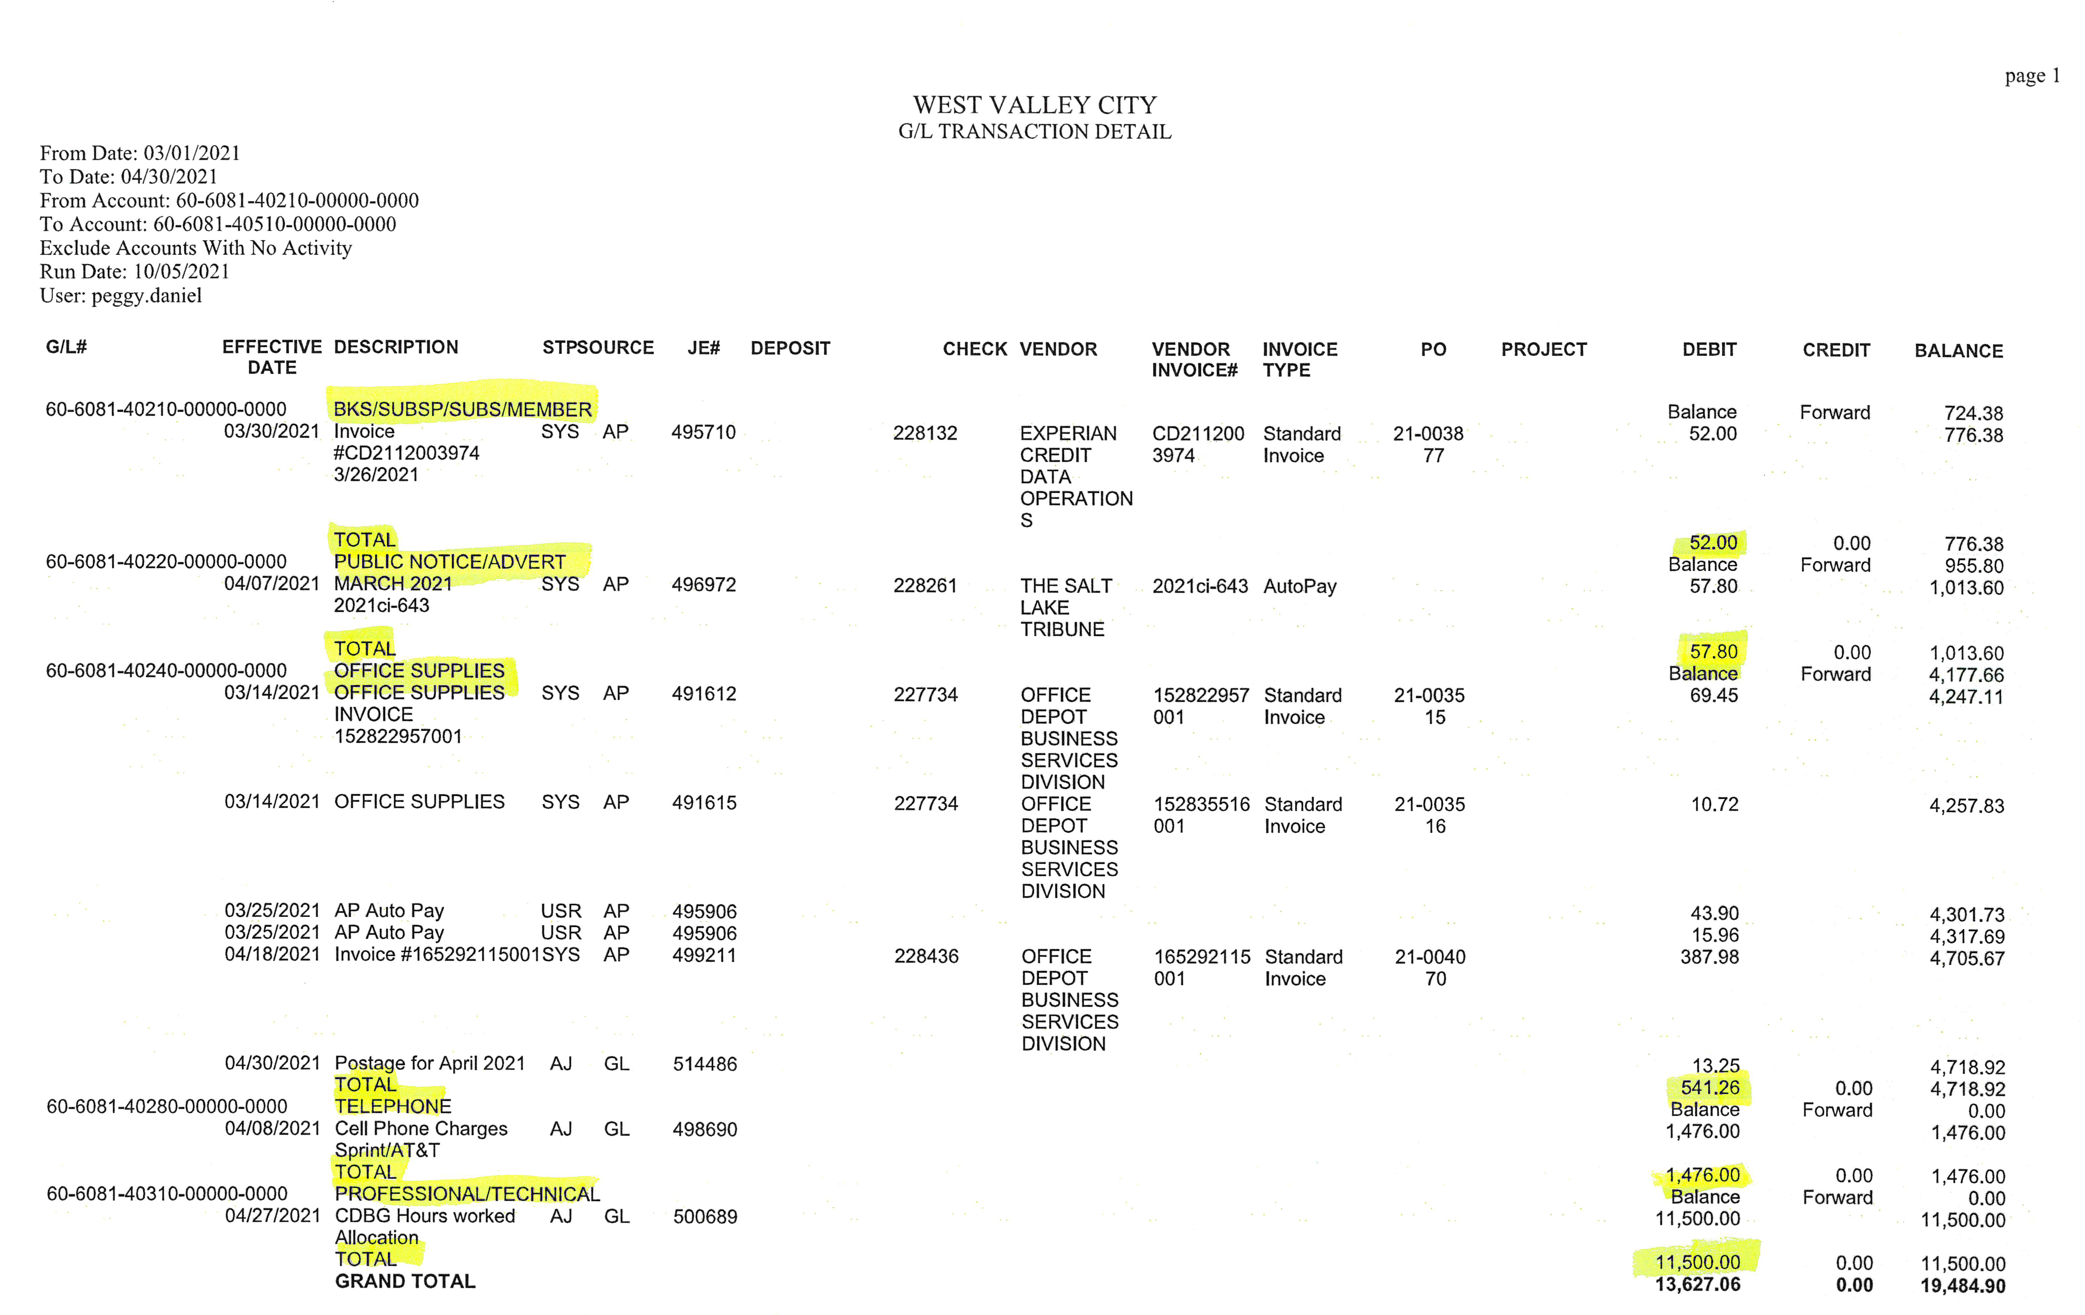
GENERAL LEDGER TRANSACTIONS

Slide 35
INVOICES
Monthly by the 15th
CDBG Disbursement Cover letter
Agency name
Summary of expenses itemized by budget categories
Brief budget narrative
Time period covered for related expenses
Contact person with phone and email
Transaction Detail Report
Statement of Expenses
Invoice/receipts

Slide 36
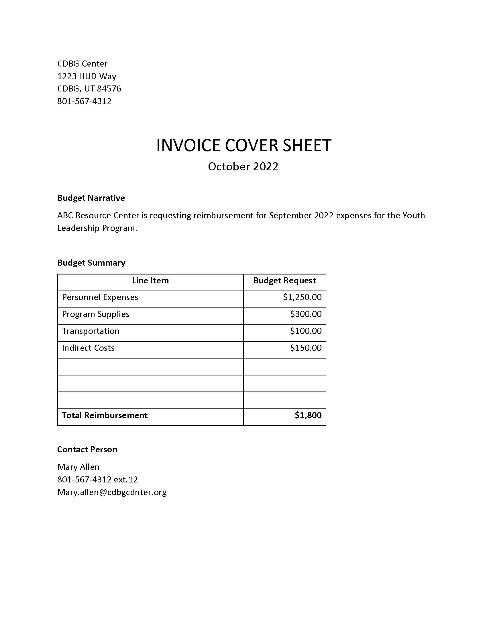
Invoice Cover Letter

Slide 37
AUDITS
The primary goal of the audit is to determine whether and agency has adequate systems in place to assure objectives are met, resources are safeguarded, regulations are followed, and reliable data is obtained and maintained.
Financial audits are designed to provide an independent opinion on the agency’s financial statements, internal central structures, cash flow, and compliance with specific financial systems and procedural requirements.
Programmatic audits provide an independent point of view on the extent to which the agency has efficiently and effectively carried out its operations and achieved the intended program results and benefit.

Slide 38
PROCUREMENT
Equipment vs Supplies
Equipment means tangible personal property (including information technology systems) having a useful life of more than one year and a per-unit acquisition cost which equals or exceeds the lesser of the capitalization level established by the non-federal entity for financial statement purposes, or $5,000. Pre-Purchase Approval Required
Supplies means all tangible personal property other than those described in § 200.33 Equipment. A computing device is a supply if the acquisition cost is less than the lesser of the capitalization level established by the non-federal entity for financial statement purposes or $5,000, regardless of the length of its useful life.
Use and Reversion of Assets

Slide 39
RECORD RETENTION
Records include but not limited to:
Financial
Program
Supporting documents
Statistical records
Personnel
Property
5 Years or longer

Slide 40
MONITORING
Types of Monitoring:
Individual Project-As Needed
Desk Review-Monthly
On-Site-Annually
Davis-Bacon-As Needed
Drawdown Requests-Submitted
The primary objective of monitoring subrecipients is to ensure compliance with regulations governing administrative, financial, and programmatic operations.

Slide 41
LAWS AND REQUIREMENTS
CIVIL RIGHTS, FAIR HOUSING, AND EQUAL OPPORTUNITY
AMERICANS WITH DISABILITIES ACT
SECTION 3/DAVIS-BACON
CONFLICT OF INTEREST
LABOR REQUIREMENTS
DISPLACEMENT AND AFFIRMATIVE MARKETING
UNIFORM RELOCATION ASSISTANCE
ENVIRONMENTAL REVIEWS

Slide 42
SECTION 3 BASICS
Purpose: empower low-income workers in the community with upward economic mobility
Trigger: total amount of federal assistance exceeds $200,000, applies to entire project regardless of full or partial federal assistance

Slide 43
SECTION 3 BUSINESSES
Section 3 Business Concern (S3BC): a business within the last six months which:
Is at least 51% owned and controlled by low- or very-low income persons
Over 75% of labor hours within the last 3 months by Section 3 workers
Is at least 51% owned/controlled by current public housing or Section 8 residents
Contractor: any entity entering a contract with a recipient to perform work in connection with a Section 3 project OR a subrecipient for work in connection with a Section 3 project
Subcontractor: any entity that has a contract with a contractor to undertake a portion of the contractor’s obligation to perform work in connection with a Section 3 project

Slide 44
SECTION 3 WORKERS
Low-income person: individual whose gross household income is at or below 80% of the area median income (AMI)
Very low-income person: individual whose gross household income is at or below 50% of the area median income (AMI)
Section 3 worker: any worker who currently, or within the last 5 years, fits one of these categories
Income for previous or annualized calendar year is below the income limit established by HUD
Employed by a Section 3 Business Concern (S3BC)
YouthBuild participant

Slide 45
TARGETED SECTION 3 WORKERS
Resident of public housing or Section 8-assisted housing
Resident of other public housing projects or Section 8-assisted housing managed by the public housing authority that is providing the assistance
YouthBuilt participant
Worker living within the service area/neighborhood of the project

Slide 46
SECTION 3 REPORTING REQUIREMENTS
Reporting year goes until June 30th, with annual report due July 30th
Total number of labor hours, including by contractors and subcontractors
Total number of labor hours by Section 3 workers
Total number of labor hours by Targeted Section 3 workers
Benchmarks:
25% or more of labor hours by Section 3 workers
5% of more of labor hours by Targeted Section 3 workers
If these are not met, must report compliance efforts and activities (including contractors/subcontractors)

Slide 47
COMPLIANCE ACTIVITIES
Outreach efforts to generate job applicants
Training/apprenticeship opportunities
Technical assistance (coaching, resume assistance)
Assist Section 3 workers seeking employment
Job fairs
Services for work readiness and retention (interview clothing, test fees, etc.)
Provision of assistance for education (4-year, community college, vocational)
Assist Section 3 workers in obtaining financial literacy training/coaching
Outreach efforts to identify/secure bids from S3BC
Technical assistance, contract division, other efforts to support viable S3BC bids
Promote specialized business registries

Slide 48
RECORDS
Section 3 qualification including:
Self-certification of income below AMI
Self-certification of participation in public/Section 8 housing
Certification from a public housing administrator
Employer’s certification of income below the limit if wage rate annualized
Employer’s certification that worker employed by a S3BC
May be reported for up to 5 years from when certified
Targeted Section 3 qualification including:
Self-certification of participation in public/Section 8 housing
Certification from public housing authority or manager of Section 8-assisted housing
Employer certification of worker employed by S3BC
Worker’s certification of YouthBuild participation
Employer certification of worker’s residence within 1 mile of work site
May be reported for up to 5 years from when certified

Slide 49
DAVIS-BACON BASICS
For each contract over $2,000 involving the US or DC as a party for construction, alteration, or repair of public buildings or public works
If triggered, sets minimum wages for laborers employed under the contract
Based on prevailing wages and fringe benefits for local area; Federal Wage determinations in four different categories based on type of work
Also applies to subcontractors and their workers

Slide 50
DAVIS-BACON REPORTING REQUIREMENTS
Beginning of project:
Certifications of non-collusion/non-discrimination
Other portions of Contractor Guide
Weekly:
Certified payroll reports for prime and sub-contractors: please send to Phil
Report of subcontractors on site, if any
Conclusion of project:
Final Project Review
Any remaining reports not yet submitted

Slide 51
WHAT’S NEW FROM HUD
Section 3 final rule:
Old way of compliance: number of Section 3 personnel on site
New way of compliance: number of Section 3/Targeted Section 3 labor hours on site
Due diligence in case benchmarks not met
Davis-Bacon and Related Acts:
Updated Certified Payroll forms, including “no work” weeks
Retention: 3 years minimum BUT defer to retention period of awarding city, whichever is longer (5 years)
Build America, Buy America Act (BABA):
All iron and steel produced in the USA
All construction materials
More to be rolled out

Slide 52
CONTRACT requirements
Contract addendum:
Section 3 clause
Non-discrimination and non-collusion statement
Hatch Act clause
Federal wage statement
Employment restrictions
CDBG compliance statement
Wage statement

Slide 53
Subrecipient Agreement
Read Thoroughly
Signed and Notarized
Appendix A – Scope of Work
Appendix B – Budget Worksheet
Appendix C – FFATA
Appendix D – Conflict of Interest
Appendix E – Key Milestones

Slide 54
Subrecipient Agreement
Certificate of Insurance
W-9
Business License
UEI Number
WVC ADA Questionnaire
Disability & Nondiscrimination Employee Information

Slide 56
WVC CDBG Program Contact
Peggy Daniel
Grants Administrator
Peggy.Daniel@wvc-ut.gov
801-963-3280
West Valley City Grants Division
4522 West 3500 South
WVC, UT 84120
Website: www.wvc-ut.gov/grants

