Slide 1


West Valley City
Subrecipient Training
July 2023
Peggy Daniel and Phil Keeve

Slide 2

WELCOME
Subrecipients are a fundamental part of the CDBG program. Your participation provides:
  Access to, and knowledge of, the specific neighborhoods and beneficiaries
  Technical & managerial capacity

Slide 3
RESPONSIBILITES
Grantee and Subrecipients share joint responsibility
  Most federal requirements are passed to Subrecipient
  Regulatory compliance & performance go together

Slide 4
CARDINAL RULE
DOCUMENTATION
If your activities, personnel, procedures, expenditures, and results are not documented properly, from the federal government’s perspective, you have not done your job, regardless of your accomplishments!

Slide 5
PROGRAM MANAGEMENT
The Community Development Block Grant Program (CDBG)
  U.S. Department of Housing and Urban Development (HUD)
  Title 1 of the Housing and Community Development Act of 1974 (HCDA), as amended.
West Valley City qualifies as an entitlement jurisdiction
  Population of over 50,000 people
  Funding allocation averages $1,100,000

Slide 6
Program Management
West Valley City—Entitlement Jurisdiction
5-Year Consolidated Plan
Annual Action Plan
Consolidated Annual Performance Report (CAPER)
Citizen Participation Plan

Slide 7
Funding limitations
Average CDBG Allocation
Activities | Percentage | Amount
Administration and Planning Cap | 20% | $220,000
Public Services Cap | 15% | $165,000
Available for Other Activities | 65% | $715,000
Total Allocation |  | $1,100,000

Slide 8
PRIMARY OBJECTIVE
The primary objective of the CDBG program is the development of viable urban communities principally for persons of low-moderate income, defined as a person residing in a household with income at or below 80% of area median income. This is achieved by providing the following, principally for persons of low and moderate income.
  Decent housing
  A suitable living environment
  Expanded economic opportunities

Slide 9
NATIONAL OBJECTIVES
National Objectives
Low/Mod Income
Slum/Blight
Urgent Needs
Area Benefit
Limited Clientele
Housing
Jobs
Area Basis
Spot Basis
Urban Renewal

Slide 10
DETERMINING ELIGIBILITY
Public Service Activities
Low-Mod Area Benefit (LMA)
Limited Clientele (LMC)
The distinguishing factor: will services be offered to all residents of a particular area? Or to a particular group of residents?

Slide 11
The definition of a low- or moderate-income person or household is having an income equal to or less than the Section 8 lower income limits established by HUD. The current HUD income limits for West Valley City are listed below:
BENEFIT TO LOW/MODERATE INCOME INDIVIDUALS
2023-2024 CDBG Income Limits
Household Number | 1 | 2 | 3 | 4 | 5 | 6 | 7 | 8
Extremely Low-Income 30% | $22,300 | $25,450 | $28,650 | $31,800 | $34,350 | $36,900 | $39,450 | $42,000
Low Income 50% | $37,100 | $42,400 | $47,700 | $53,000 | $57,250 | $61,500 | $65,750 | $70,000
Moderate Income 80% | $59,400 | $67,850 | $76,350 | $84,800 | $91,600 | $98,400 | $105,200 | $111,950

Slide 12
Area Benefit
Low-Mod Area Benefit activities must be available to all residents of an area where at least 51% of residents are LMI. The area must be clearly defined and primarily residential. Required documentation of this objective consist of:
  Maintain records of the boundaries of the service area.
  Document that the area is primarily residential (e.g., zoning map); and
  Document the income characteristics of households in the service area (e.g., Census Data)
  Typical Activities
    Construction
    Graffiti abatement
    Community facilities
    Construction of water and sewer line improvements

Slide 13
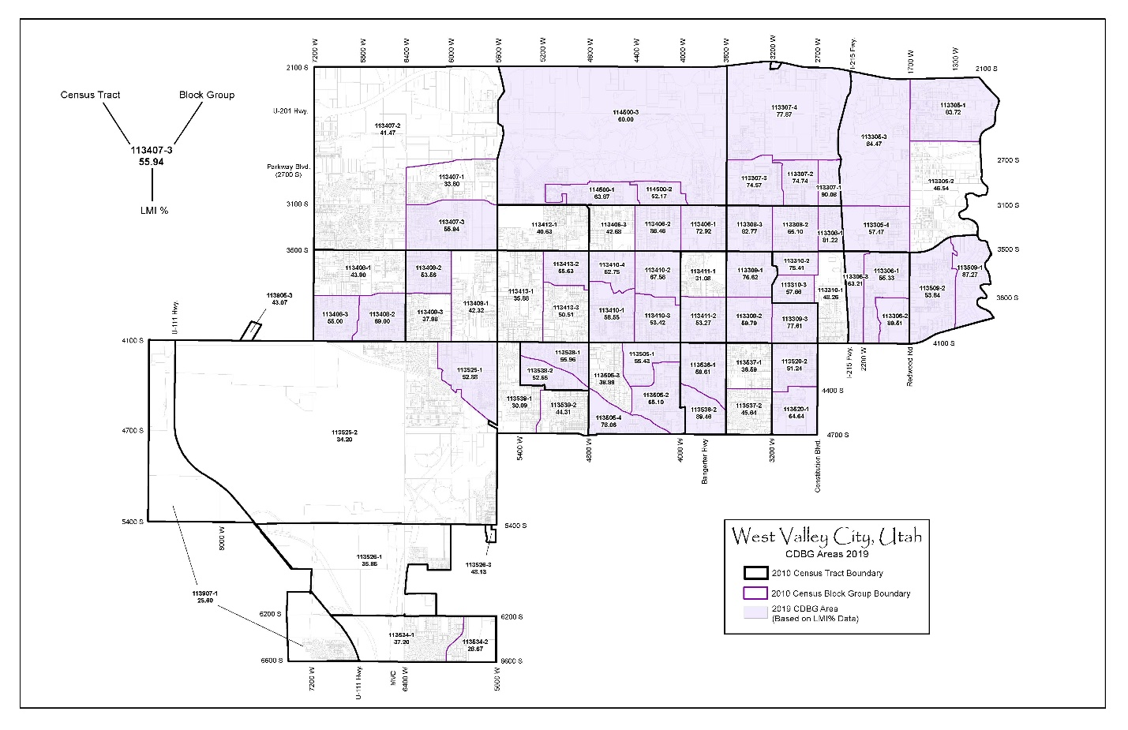

Slide 14
LIMITED CLIENTELE
Low-Mod Income Limited Clientele (LMC) is an activity which provides benefits to a specific group of persons. At least 51% of the beneficiaries of the activity must be Low-Mod income persons. To qualify under LMC, a client must meet one of the following tests:
Test 1-Limited Clientele Based on Presumed Benefit
  Clients who are generally presumed by HUD to be principally LMI persons. These include:
    Abused children
    Elderly persons 62 years of age
    Domestic violence survivors
    Homeless persons
    Illiterate adults
    Persons living with AIDS
    Migrant farm workers
    Severely disabled persons; HUD defined

Slide 15
LIMITED CLIENTELE
Records to be maintained for presumed benefit:
Subrecipients must collect and retain documentation showing that the activity is designed to be used exclusively by one of these presumed low-income groups. Examples of source documentation include but not limited to:
  Abused children – referral documenting “abused child status”
  Seniors – copy of ID, driver’s license, or Social Security Award Letter
  Disabled – receipt of disability check or SSDI award letter, or a doctor’s note verifying disability

Slide 16
LIMITED CLIENTELE
Test 2-Limited Clientele Based on Family Size and Income
  Requires information on family size and income from every client 18 and over in a household to prove that clients are persons whose family income does not exceed the low – moderate income limit.
  Records to be maintained for Family Size and Income: Subrecipients must collect and retain documentation showing the household size and household annual income of each person receiving the benefit.

Slide 17
The definition of a low- or moderate-income person or household is having an income equal to or less than the Section 8 lower income limits established by HUD. The current HUD income limits for West Valley City are listed below:
BENEFIT TO LOW/MODERATE INCOME INDIVIDUALS
2023-2024 CDBG Income Limits
Household Number | 1 | 2 | 3 | 4 | 5 | 6 | 7 | 8
Extremely Low-Income 30% | $22,300 | $25,450 | $28,650 | $31,800 | $34,350 | $36,900 | $39,450 | $42,000
Low Income 50% | $37,100 | $42,400 | $47,700 | $53,000 | $57,250 | $61,500 | $65,750 | $70,000
Moderate Income 80% | $59,400 | $67,850 | $76,350 | $84,800 | $91,600 | $98,400 | $105,200 | $111,950

Slide 18
LIMITED CLIENTELE
Documentation for Family Size and Income
Requires gross amount, before any payroll deductions when calculating income.
Income source must be current (within 90 days).
  Wages, salaries, overtime pay, commissions, fees, tips & bonuses
  Unemployment payments
  Disability compensations
  Worker’s compensation
  Severance pay
  Alimony & child support
  Social Security Income

Slide 19
LIMITED CLIENTELE
Unless presumed by HUD to be low-moderate income, actual verification of the household income must be provided. If a client has no proof of income a penalty of perjury statement can be completed. The client should be made to understand that they are signing a legal document, and that they are certifying the truth of the information provided.
Income Documentation
  Employment check stub
  Social Security/Disability Income Award Letter
  Child Support documentation
  TANF benefits letter
  Unemployment benefits letter
  Veterans Administration award letter

Slide 20
MATRIX CODES
Matrix codes are used to indicate—but do not establish—activity eligibility.
An activity must be eligible in accordance with the regulations at 570.201 – 570.207.
Matrix codes categorize activities for reporting purposes.
  Identify the purpose
  Determine the type of accomplishment units

Slide 21
GOALS AND PERFOMANCE MEASURES
  HUD DEFINITIONS

Slide 22
GOALS
Goals closely mirror the statutory objectives of the program. The goals are framed broadly to capture the range of community impacts that occur because of program activities.
Creating a Suitable Living Environment - Activities that are designed to benefit communities, families, or individuals by addressing issues in their living environment.
Providing Decent Housing - Covers the wide range of housing activities that could be undertaken with CDBG funds.
Creating Economic Opportunities - Applies to activities related to economic development, commercial revitalization, or job creation.

Slide 23
OUTCOMES
Outcomes help further refine the activity goal and is designed to capture the nature of the change or the expected result of the goal that an activity seeks to achieve. Outcomes correspond to the question "What is the type of change the activity is seeking? Or what is the expected result of the activity?"
Availability/Accessibility - Applies to activities that make services, infrastructure, public services, public facilities, housing, or shelter available or accessible to LMI people, including persons with disabilities.
Affordability - Applies to activities that provide affordability in a variety of ways to LMI people such as lowering the cost, improving the quality, or increasing the affordability of a product or service to benefit a low-income household.
Sustainability - Applies to activities that are aimed at improving communities or neighborhoods, helping to make them livable or viable by providing benefit to persons of LMI or by removing or eliminating slums or blighted areas, through multiple activities or services that sustain communities or neighborhoods.

Slide 24
Outputs
Outputs are the quantifiable products of the project. They are usually measured in terms of the volume of work accomplished, such as the number of low or very low-income people served.

Slide 25
SCOPE
OF WORK
  APPENDIX A: SCOPE OF SERVICE

Slide 26
Program
Reports
Monthly Progress reports are due by the 15th of each month.
Client demographic
Number clients served
Narrative highlighting progress in meeting objectives
Major benchmarks, goals, outcomes, outputs, and changes in the program

Slide 27

Program
Report
Questions

Slide 28


Slide 29
FINANCIAL MANAGEMENT
Payment Reimbursement
  Actual direct costs incurred
  Eligible and allowable costs and expenses:
    Personnel/staff (salary and benefits)
    Overhead
    Indirect Costs
    Facility rental or leasing costs
    Materials or supplies
    Communications
    Travel/mileage

Slide 30
FINANCIAL MANAGEMENT
Ineligible Cost Examples:
    Programs that do not serve primarily low-moderate income persons
    Programs that promote religion
    Political activities
    Marketing, incentives, or fundraising
    Payment of debt or expenses incurred prior to agreement
    Entertainment, furnishings, or personal property
    Generally, equipment, unless necessary to implement an eligible activity

Slide 31
Budget Worksheet
 | Agency Name: | CDBG Center
 | Project Title: | Youth Leadership Program
 | Fiscal Year: | 2022-2023
 | Total Program Cost: | $100,000.00
 | WVC Program Cost Requested: | $20,000.00
 | Budget Line Item | WVC CDBG Funding | LMC Foundation | PWL Foundation | Other Funding | Total Project Funding
 | Personnel Expenses | $15,000.00 | $36,818.00 | $18,182.00 |  | $70,000.00
 | Program Supplies | $2,682.00 | $3,227.00 |  |  | $5,909.00
 | Training |  | $5,000.00 |  |  | $5,000.00
 | Transportation | $500.00 | $4,500.00 |  |  | $5,000.00
 | Communications |  | $5,000.00 |  |  | $5,000.00
 | Indirect Costs | $1,818.00 | $5,455.00 | $1,818.00 |  | $9,091.00
 | TOTAL PROJECT COST | $20,000.00 | $60,000.00 | $20,000.00 | $0.00 | $100,000.00

Slide 32
Budget costs
Personnel Costs
  Personnel Wages – Costs associated with the positions identified in the budget. Costs should reflect the actual amount of time each position spends on the program.
  Fringe Benefits – Payroll related costs of FICA, Worker’s Compensation, health insurance, sick time, vacation, retirement, etc.
Time Records
  Time records—indicating hours worked, sick, vacation, holiday, etc.
  Timesheets—recorded each day and signed by both employee and supervisor
  Timesheets—labor distribution and time project log that documents time spent on the program must be kept for all grant funded employees
  Copies of timesheets must be submitted with reimbursement request if claiming personnel costs

Slide 33
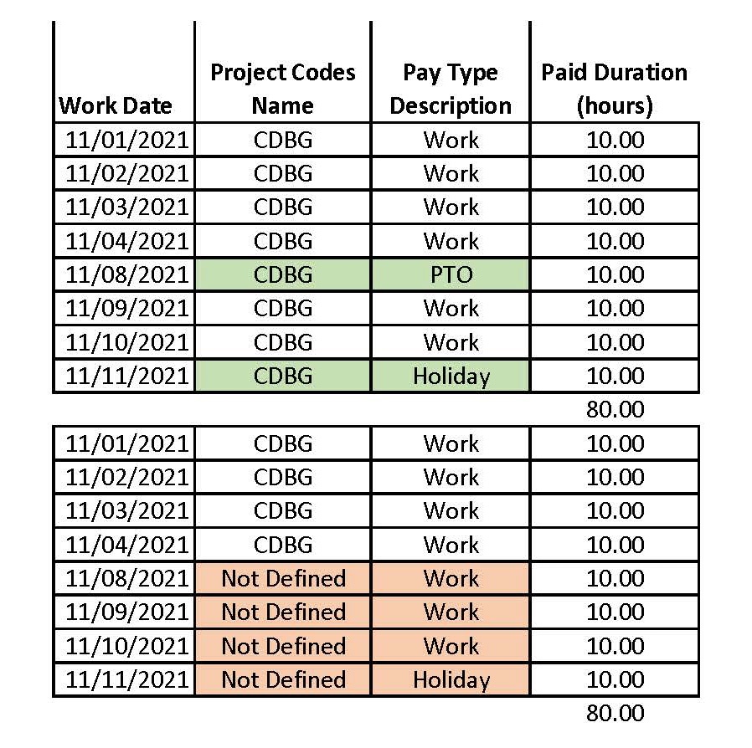
WVC PAYROLL/
TIMESHEET

Slide 34
Budget Costs
Operating Costs/Program Delivery
  Supplies: Consumable commodities Direct Client Supportive Services – Rent, bus passes, food utilities, childcare, clothing, hygiene kits and other program costs paid on behalf of clients
  Communication: Telephone, telephone installation, and postage
  Printing: Copying, printing, paper, ink, and copy machine
  Utilities: Electricity, gas, water, and trash removal
  Rent: Rental costs for real property or office space for program
  Travel: Mileage reimbursement for conducting program objectives
  Insurance: Insurance related costs required for the operation of the program
  Entertainment costs is not an allowable expense and will not be reimbursed

Slide 35
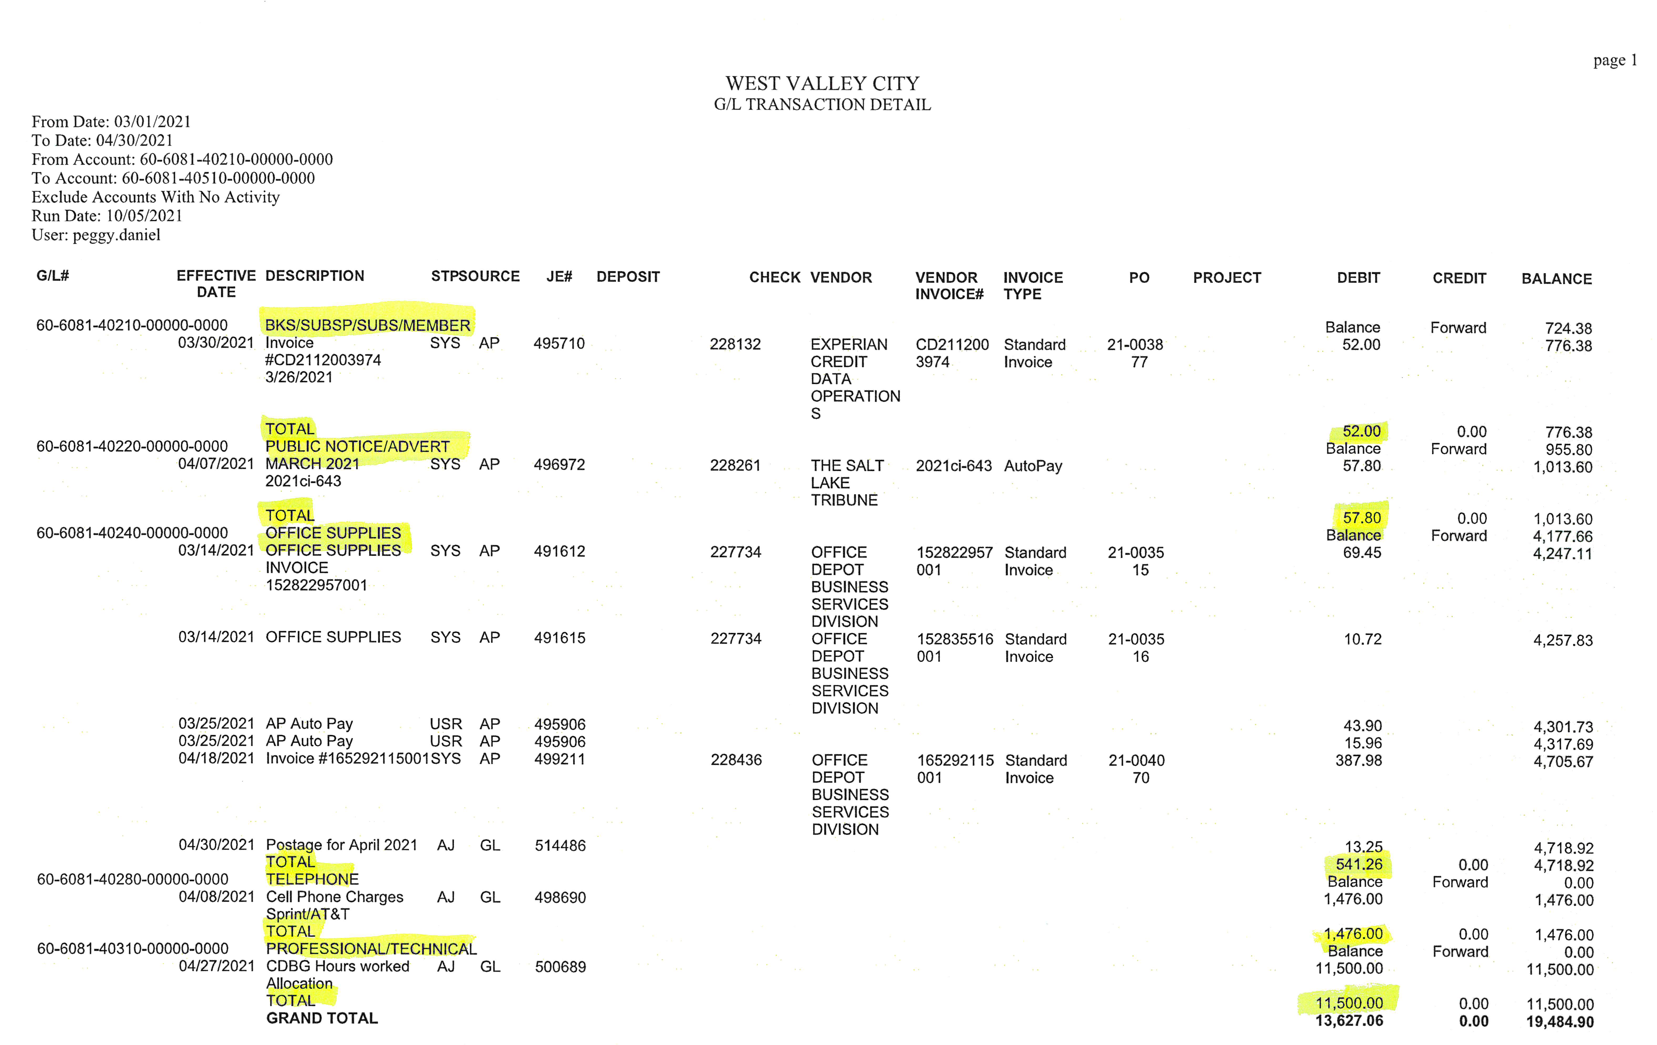
GENERAL
LEDGER
TRANSACTIONS

Slide 36
INVOICES
Monthly by the 15th
CDBG Disbursement Cover letter
  Agency name
  Summary of expenses itemized by budget categories
  Brief budget narrative
  Time period covered for related expenses
  Contact person with phone and email
Transaction Detail Report
Statement of Expenses
Invoice/receipts
Timesheets/check stubs
Proof of employee payment must be submitted

Slide 37
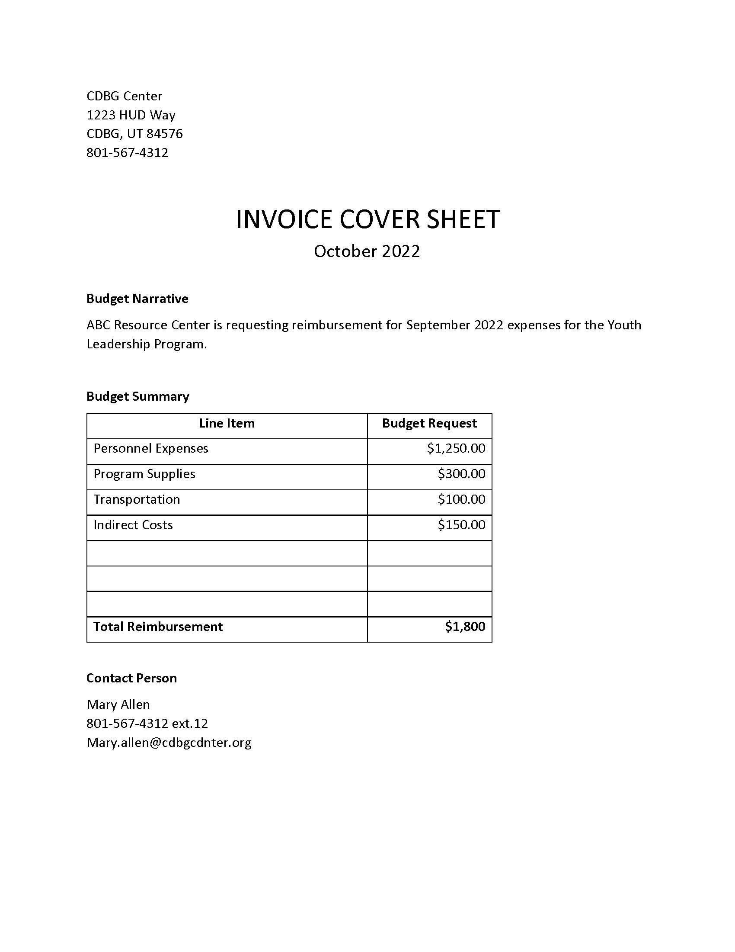
Invoice Cover Letter

Slide 38
AUDITS
The primary goal of the audit is to determine whether and agency has adequate systems in place to assure objectives are met, resources are safeguarded, regulations are followed, and reliable data is obtained and maintained.
Financial audits are designed to provide an independent opinion on the agency’s financial statements, internal central structures, cash flow, and compliance with specific financial systems and procedural requirements.
Programmatic audits provide an independent point of view on the extent to which the agency has efficiently and effectively carried out its operations and achieved the intended program results and benefit.

Slide 39
PROCUREMENT
Equipment vs Supplies
  Equipment means tangible personal property (including information technology systems) having a useful life of more than one year and a per-unit acquisition cost which equals or exceeds the lesser of the capitalization level established by the non-federal entity for financial statement purposes, or $5,000. Pre-Purchase Approval Required
  Supplies means all tangible personal property other than those described in § 200.33 Equipment. A computing device is a supply if the acquisition cost is less than the lesser of the capitalization level established by the non-federal entity for financial statement purposes or $5,000, regardless of the length of its useful life.
Use and Reversion of Assets

Slide 40
RECORD RETENTION
Records include but not limited to:
  Financial
  Program
  Supporting documents
  Statistical records
  Personnel
  Property
5 Years or longer

Slide 41
MONITORING
  Types of Monitoring:
    Individual Project-As Needed
    Desk Review-Monthly
    On-Site-Annually
    Davis-Bacon-As Needed
    Drawdown Requests-Submitted
  The primary objective of monitoring subrecipients is to ensure compliance with regulations governing administrative, financial, and programmatic operations.

Slide 42
LAWS AND REQUIREMENTS
  CIVIL RIGHTS, FAIR HOUSING, AND EQUAL OPPORTUNITY
  AMERICANS WITH DISABILITIES ACT
  CONFLICT OF INTEREST
  DISPLACEMENT AND AFFIRMATIVE MARKETING
  ENVIRONMENTAL REVIEWS

Slide 43
Subrecipient Agreement
  Read Thoroughly
  Signed and Notarized
  Appendix A – Scope of Work
  Appendix B – Budget Worksheet
  Appendix C – FFATA
  Appendix D – Conflict of Interest

Slide 44
Subrecipient Agreement
  Certificate of Insurance
  W-9
  Business License
  UEI Number
  WVC ADA Questionnaire
  Disability & Nondiscrimination Employee Information

Slide 45


Slide 46
WVC CDBG Program
Contact
Peggy Daniel
Grants Administrator
Peggy.Daniel@wvc-ut.gov
801-963-3280
West Valley City Grants Division
4522 West 3500 South
WVC, UT 84120
Website: www.wvc-ut.gov/grants

